Slide 1

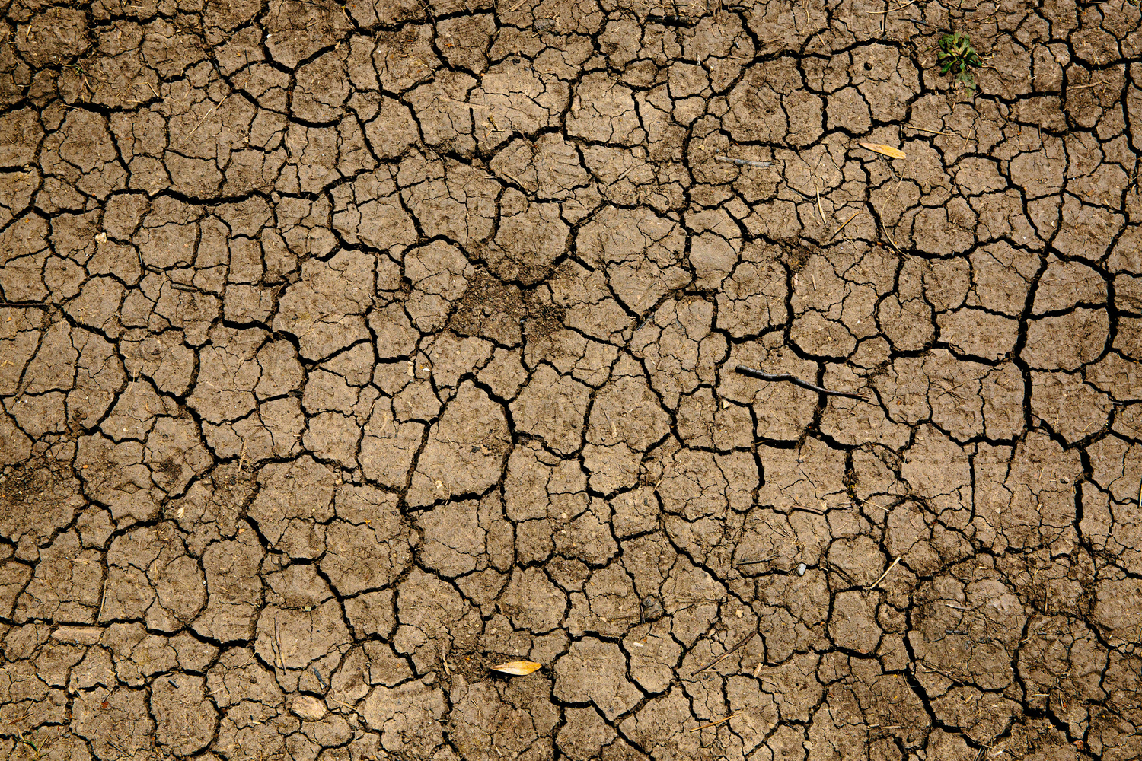
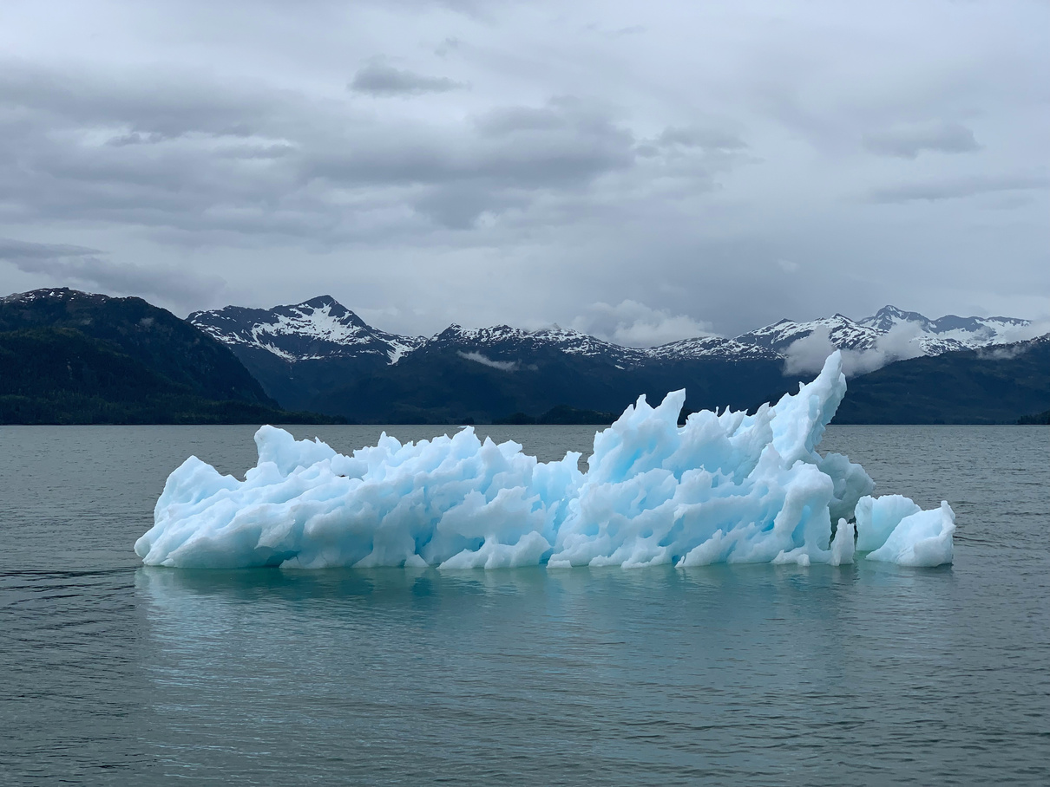

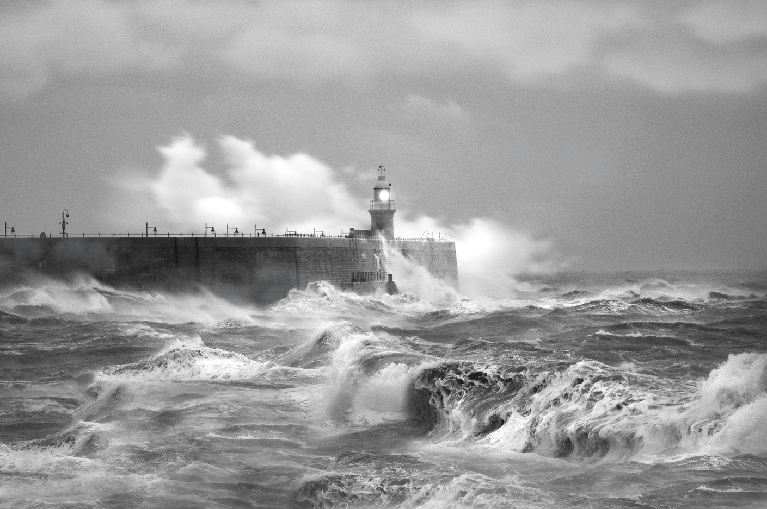
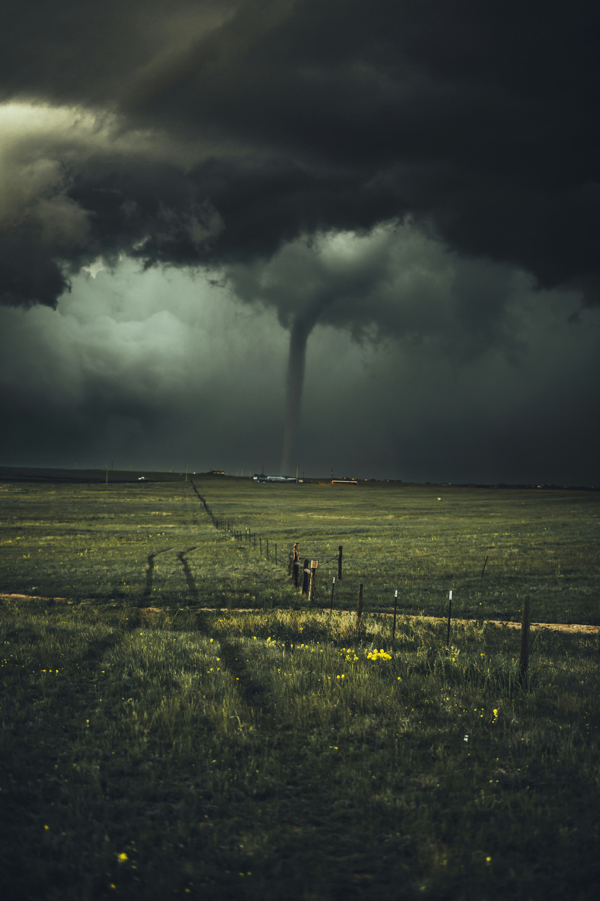
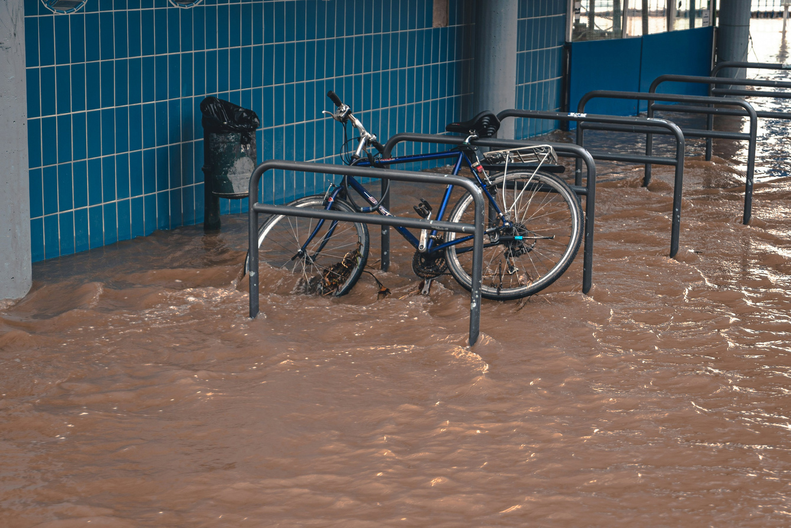
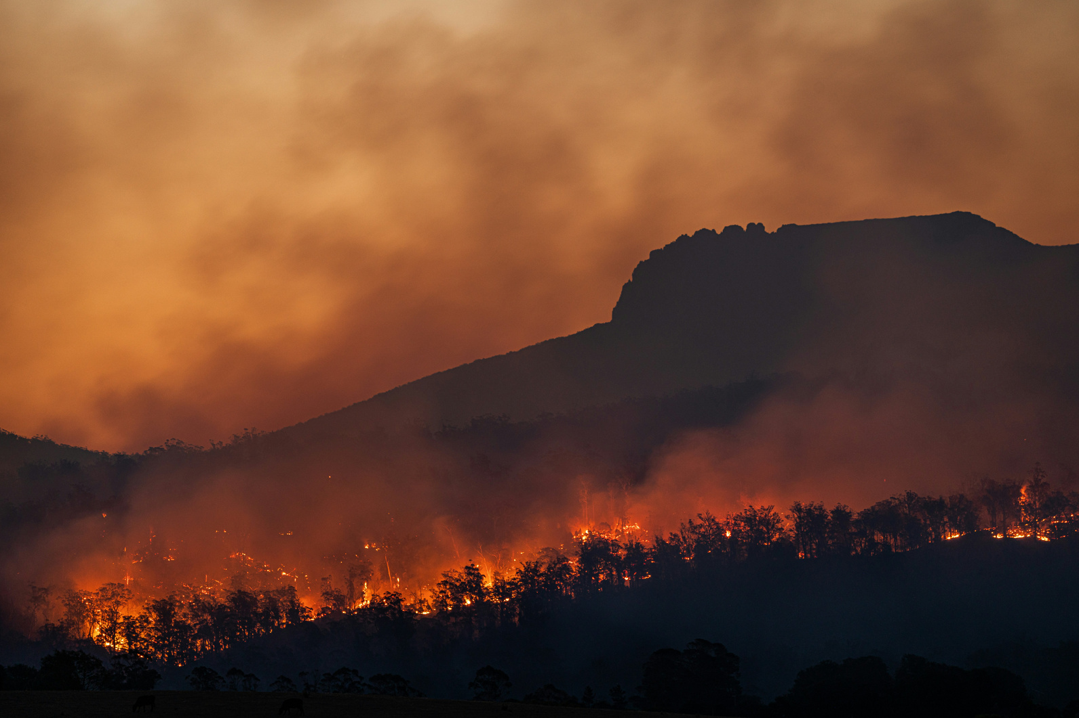

What’s
the link?

Slide 2
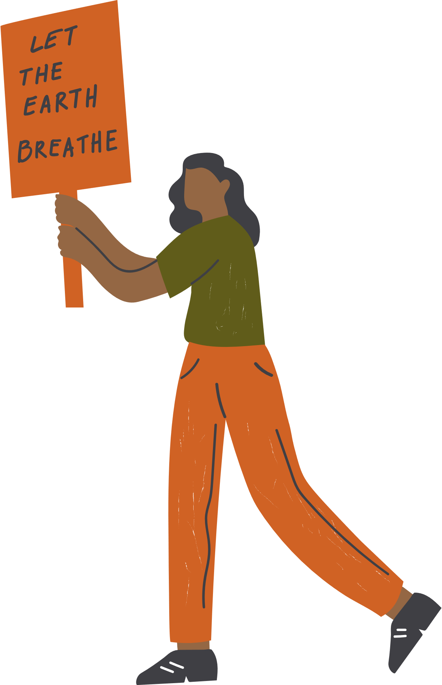

Lesson objectives
To learn that climate change has an impact on communities around the world
To find out about some of the ways
The Salvation Army is fighting against climate change
To consider ways of taking action to prevent climate change
What are you learning?

Slide 3

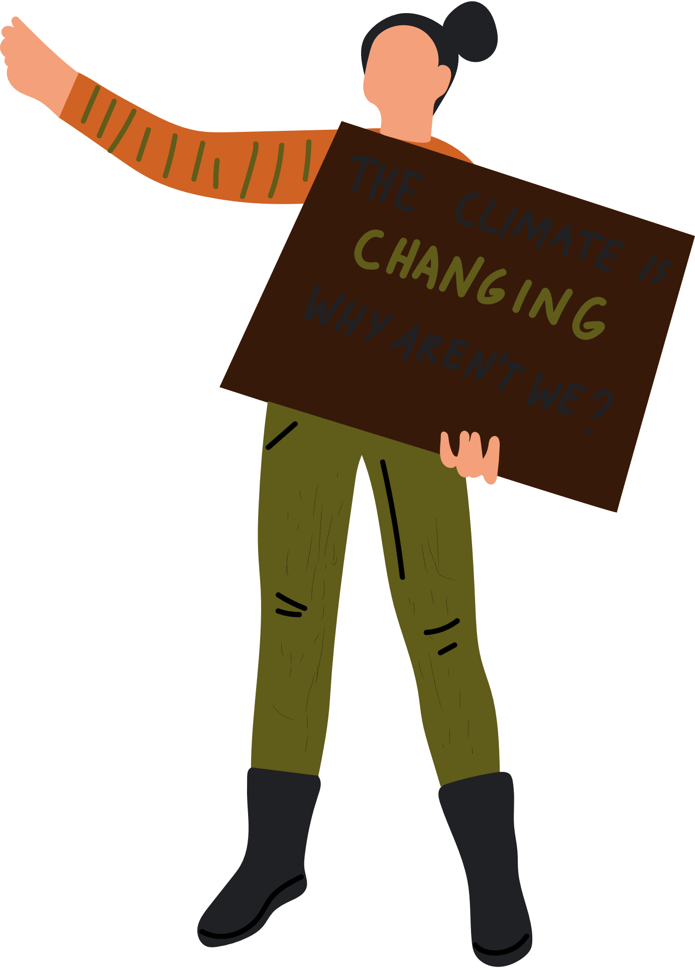


Climate Change
What is it?

Slide 4
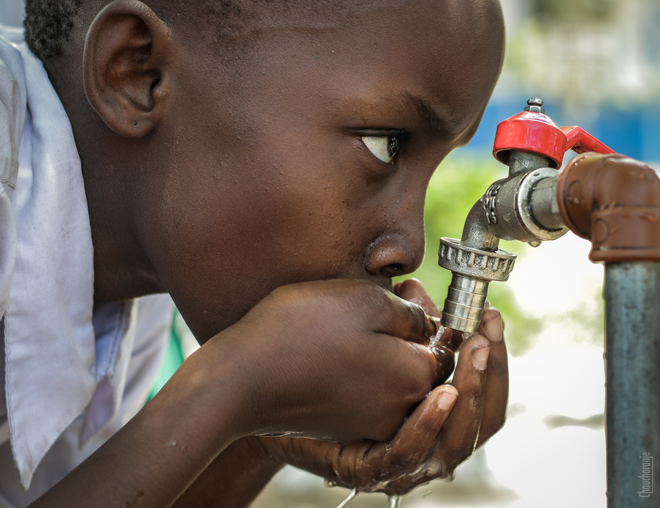

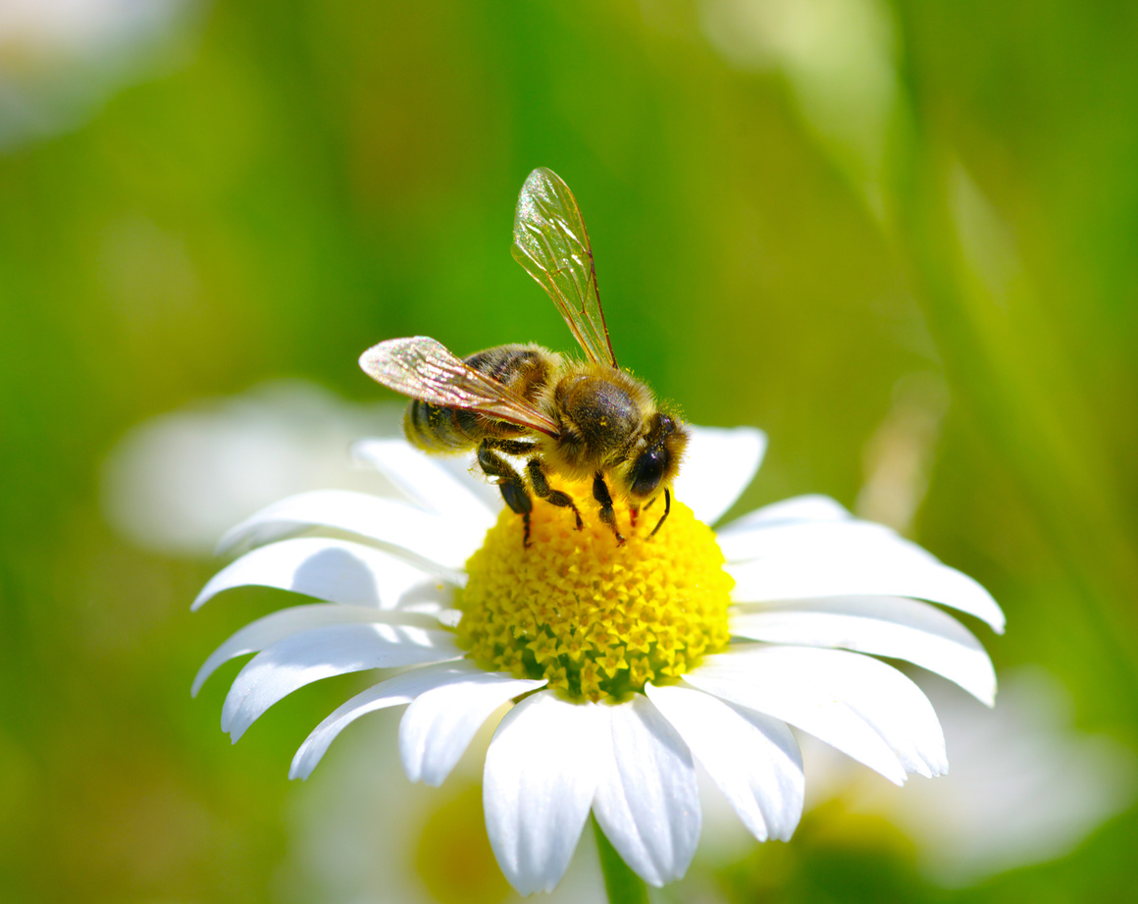
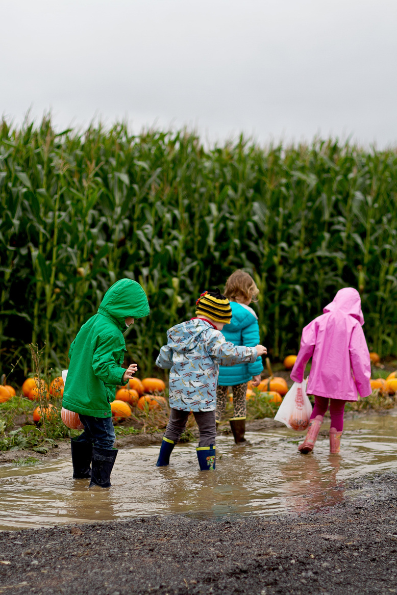
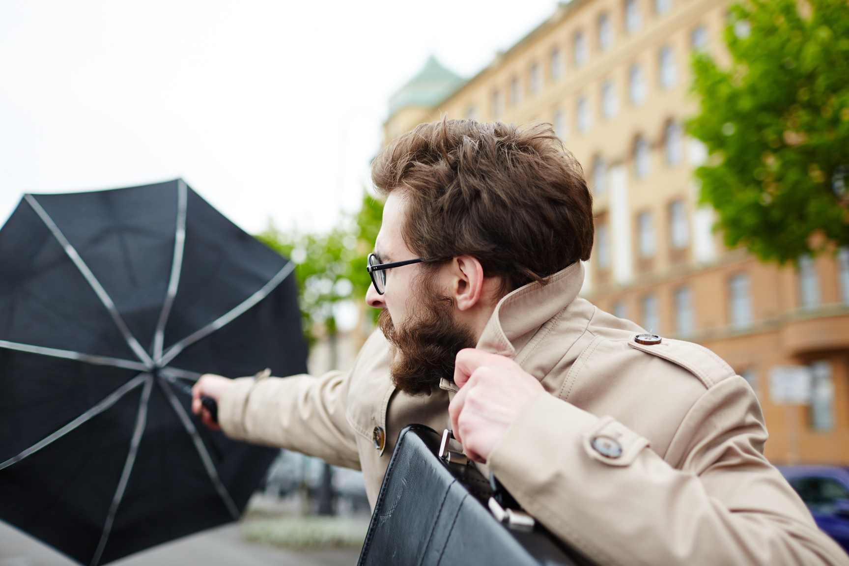

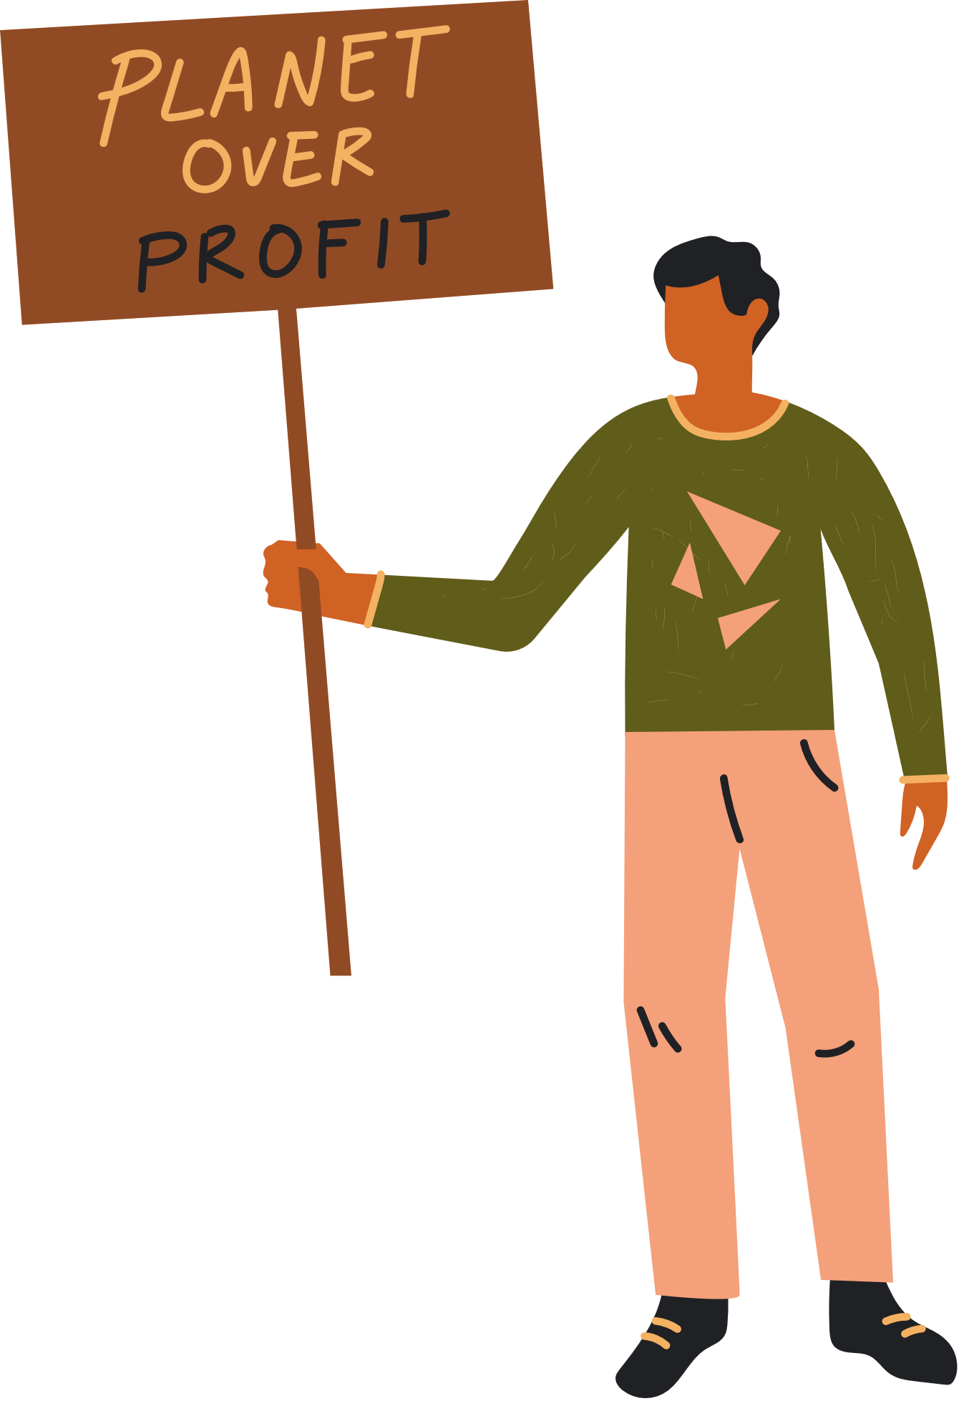

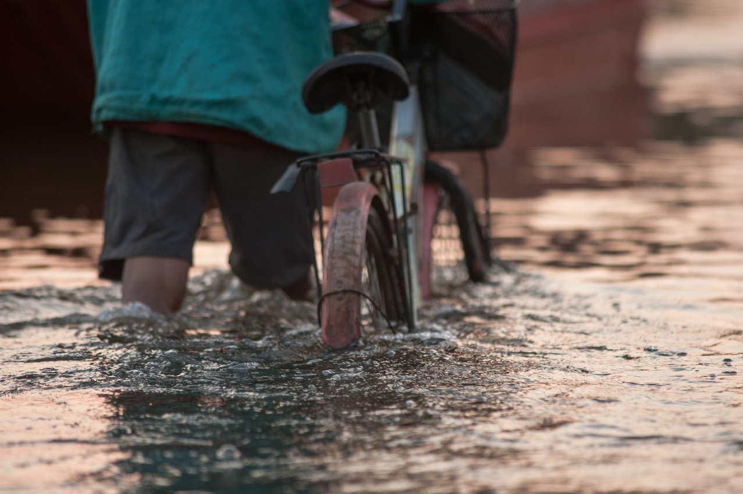
What’s happening near us?

Slide 5
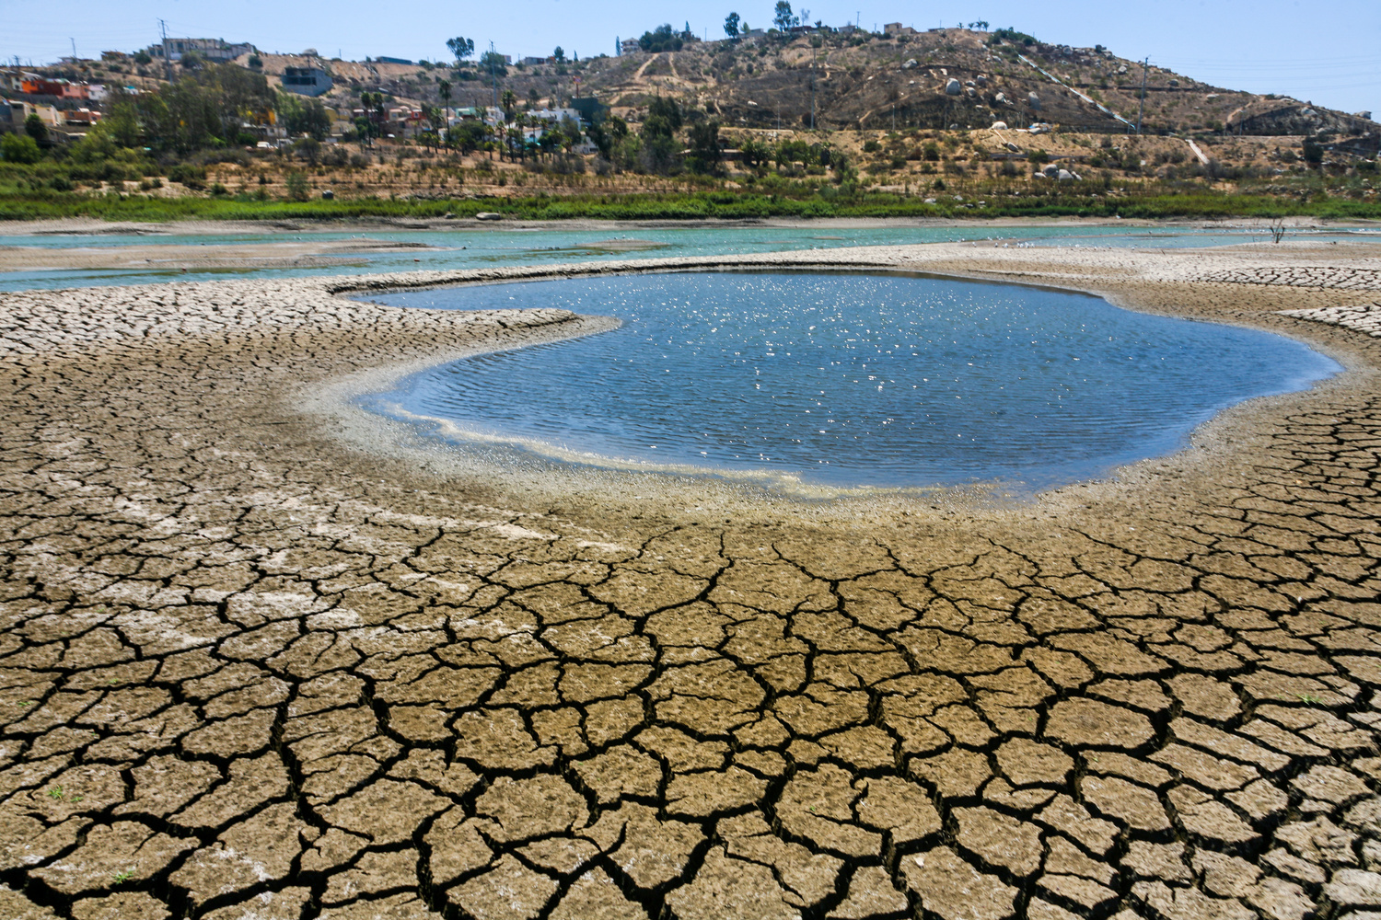


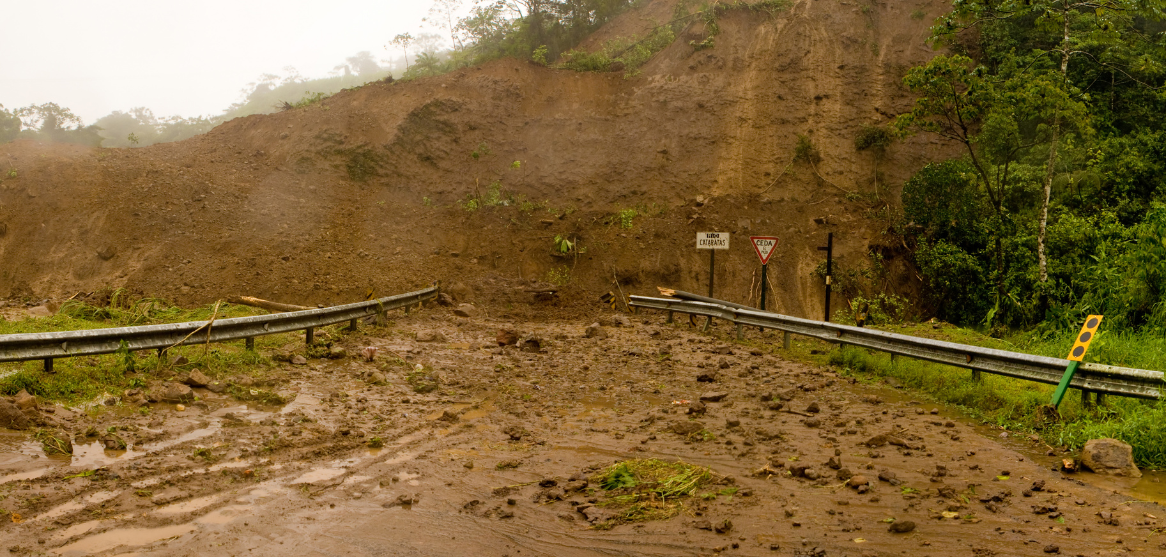
Climate change

Slide 6

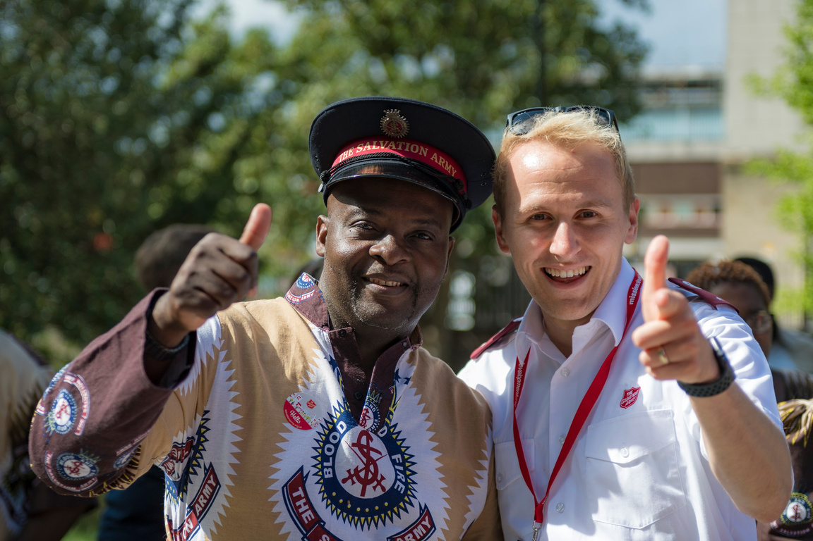
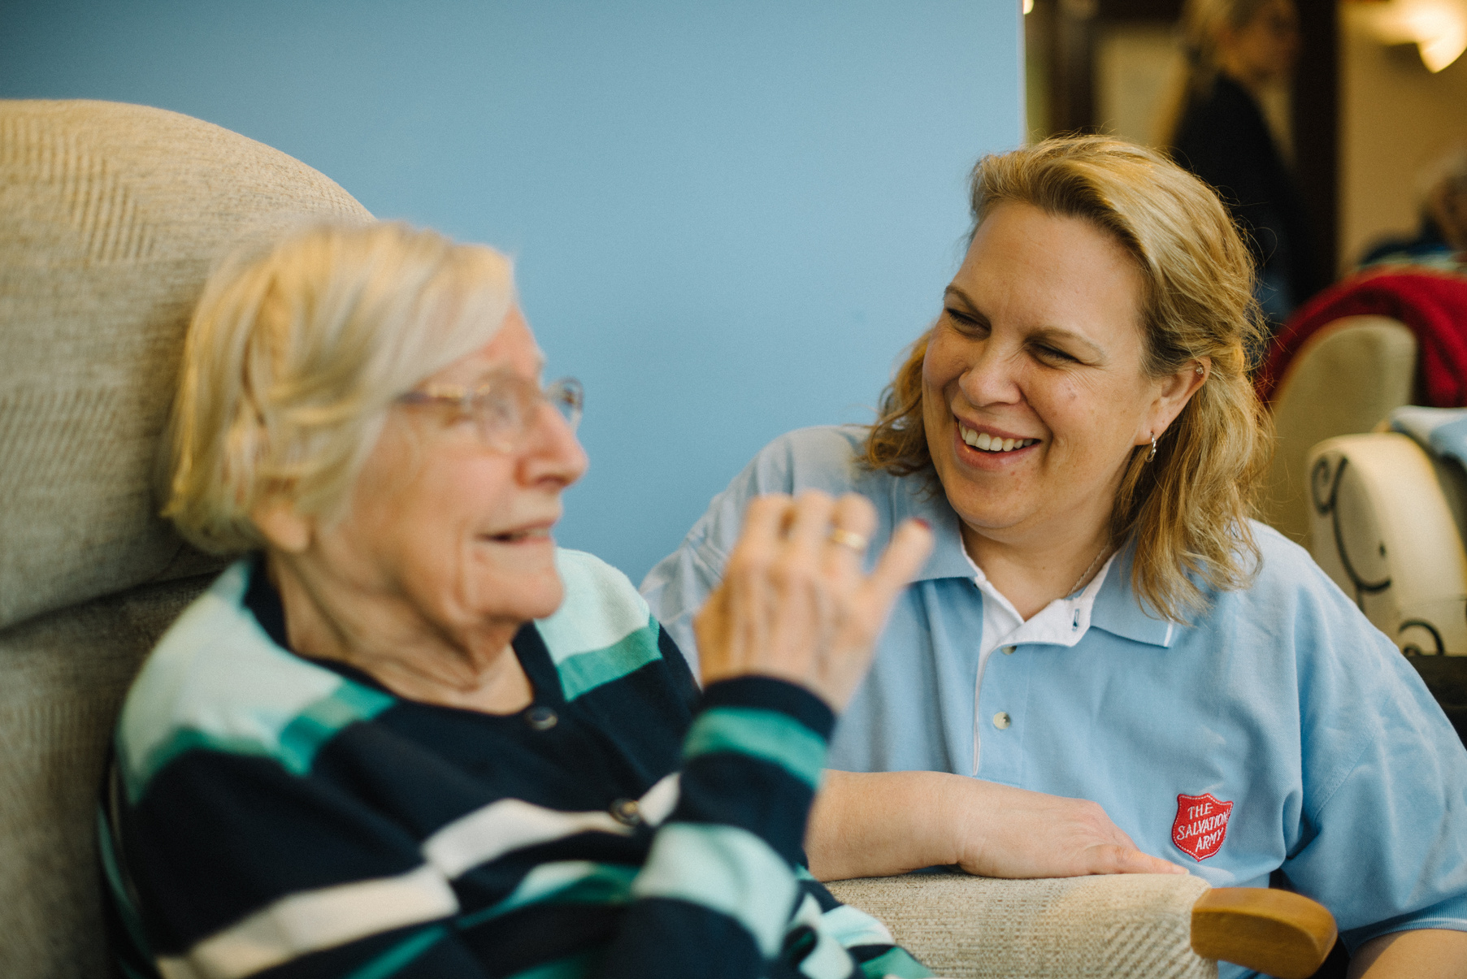
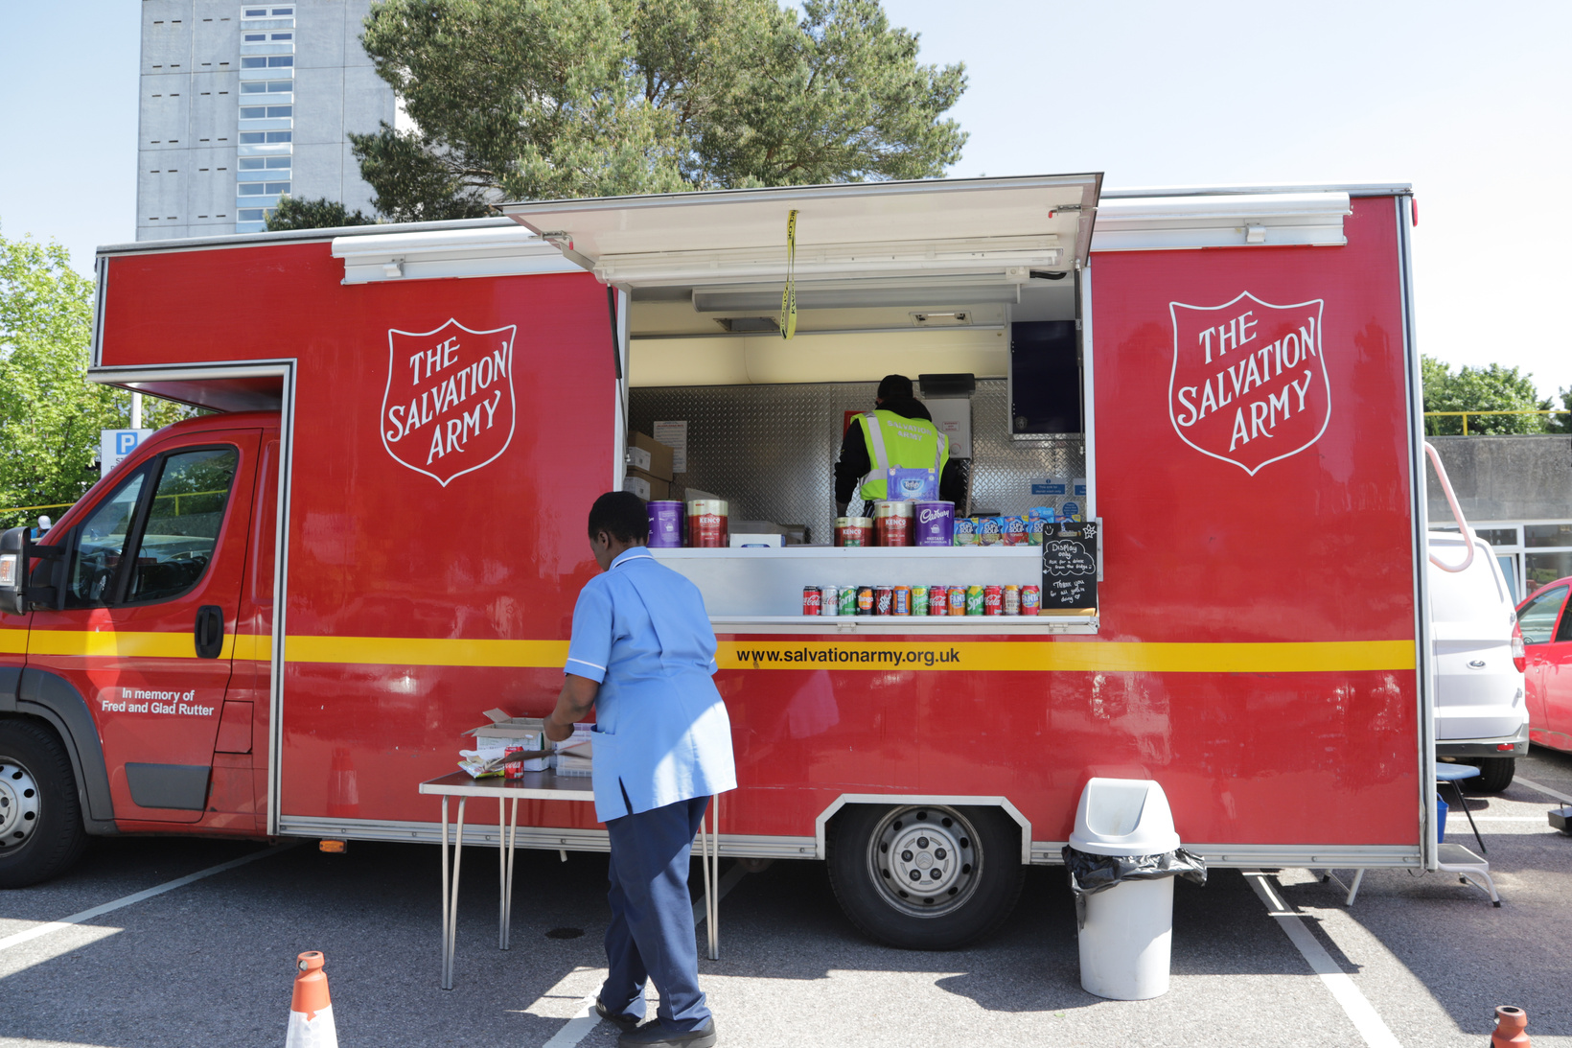
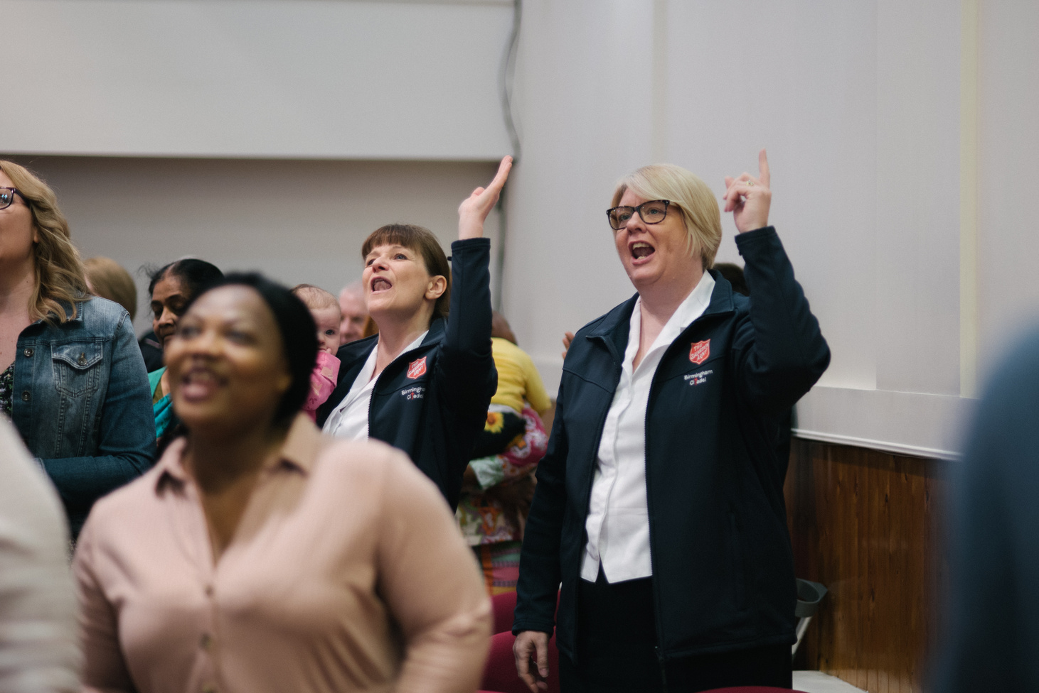
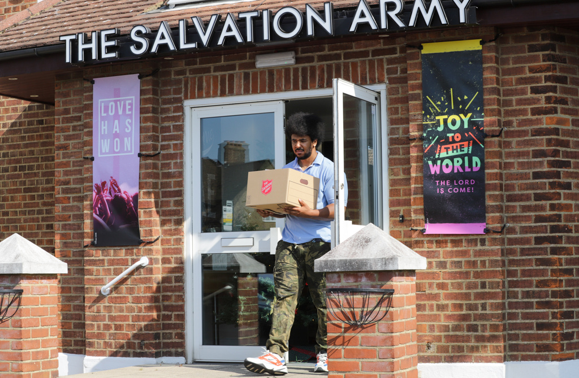
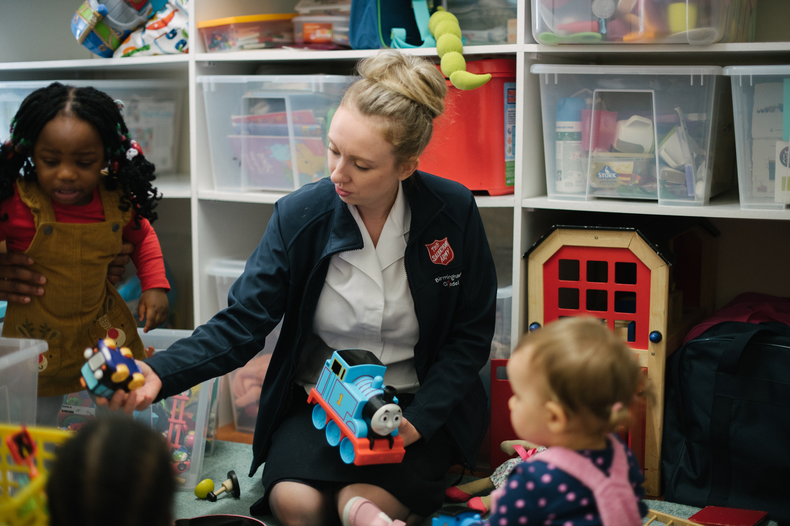
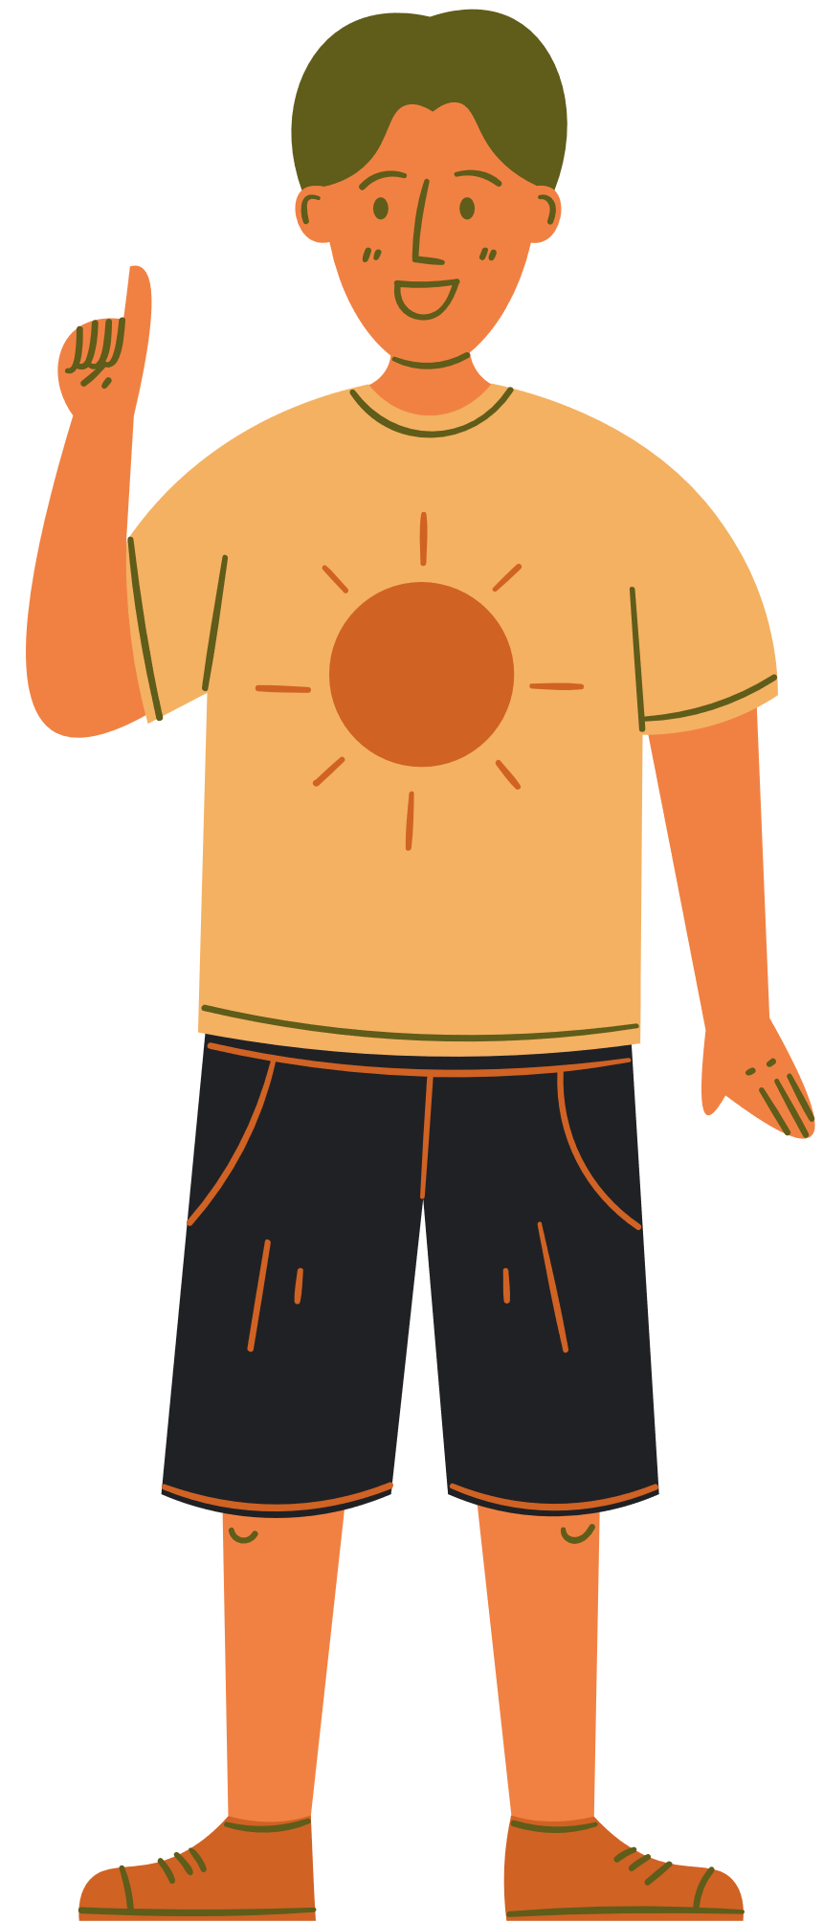
The Salvation Army
fighting for fairness

Slide 7



Exploring photos
What do you notice about these photos?
Use these prompts to help you.
What can you see?
What do you wonder?
What do you know?

Slide 8
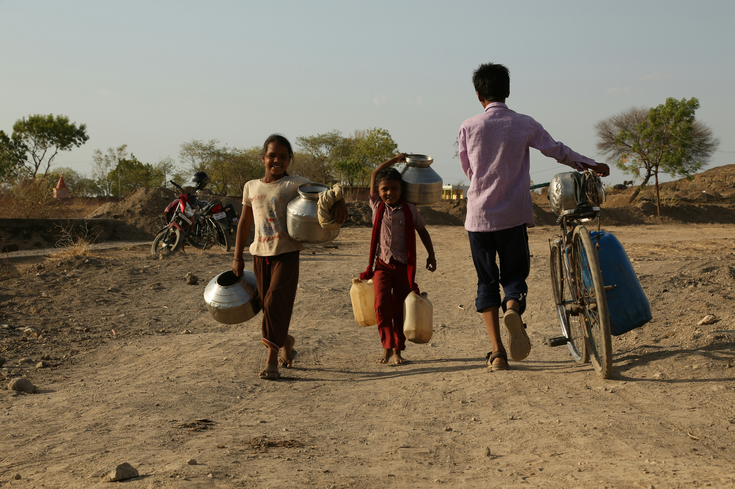
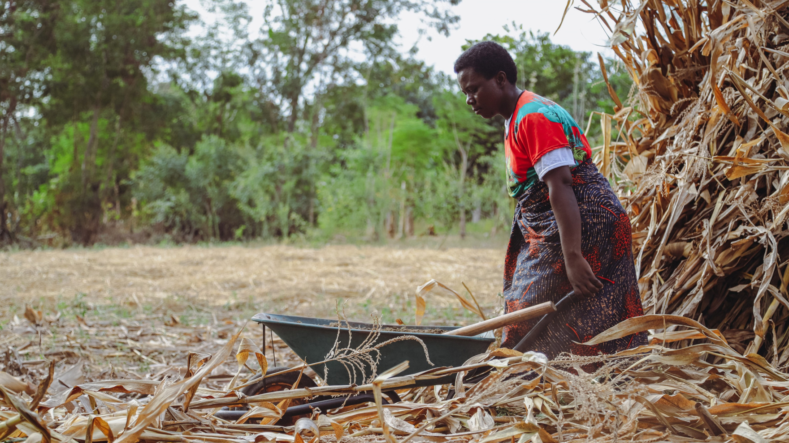

See
Wonder
Know

Slide 9
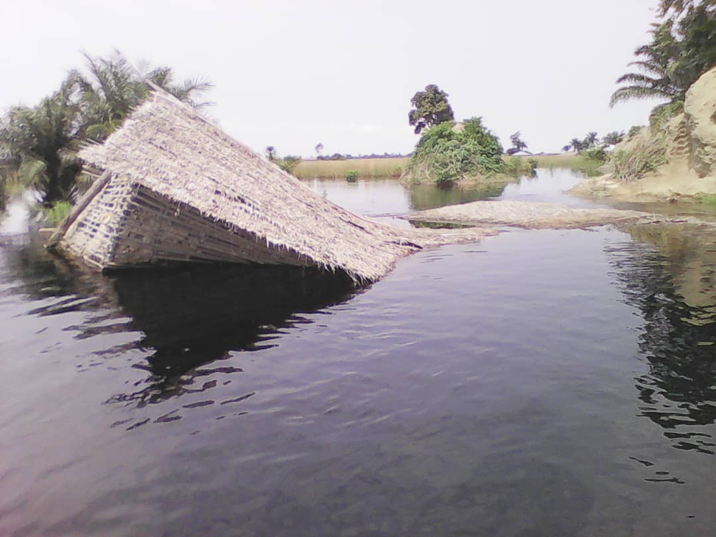
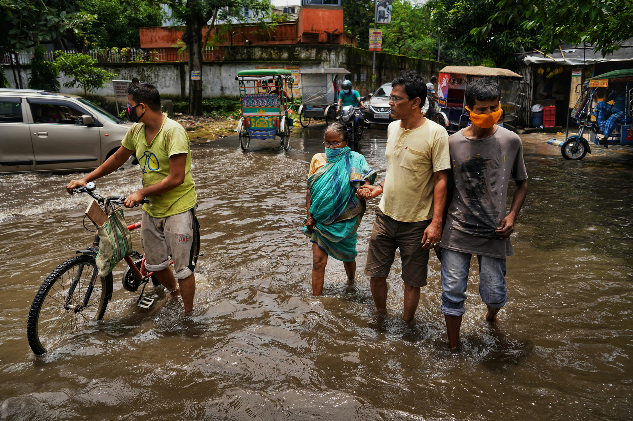
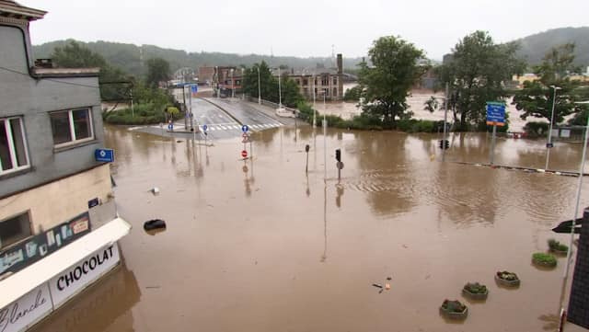
See
Wonder
Know

Slide 10
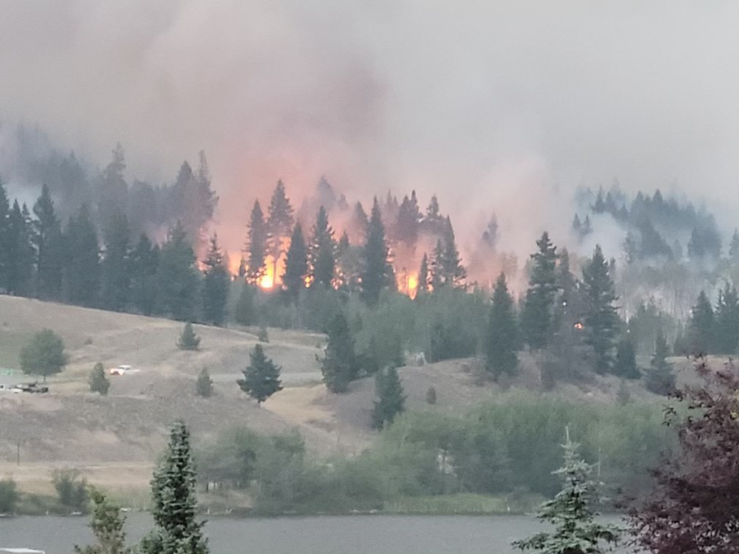
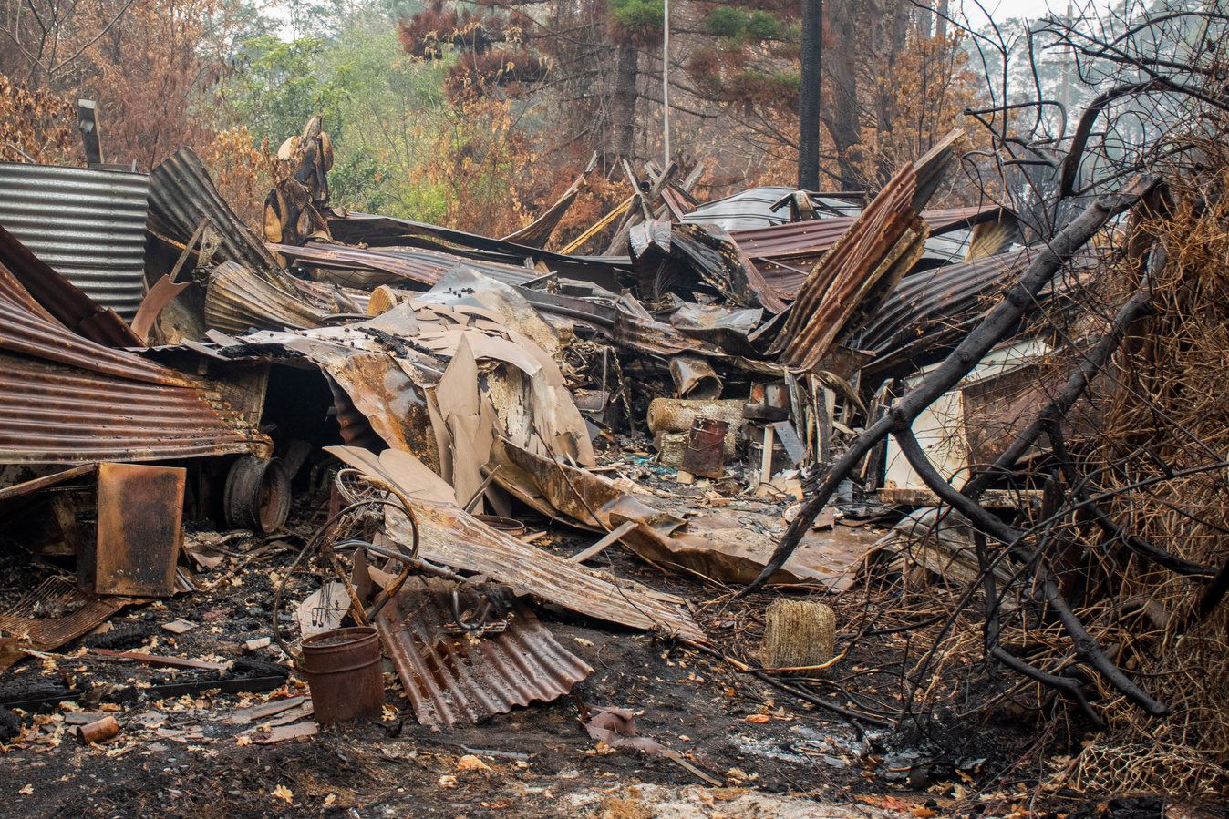
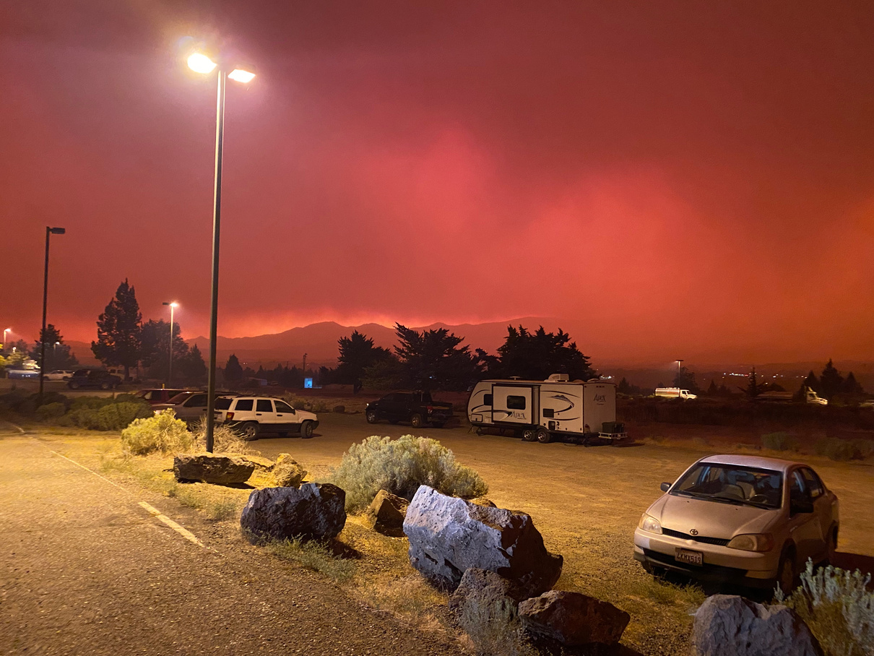
See
Wonder
Know

Slide 11
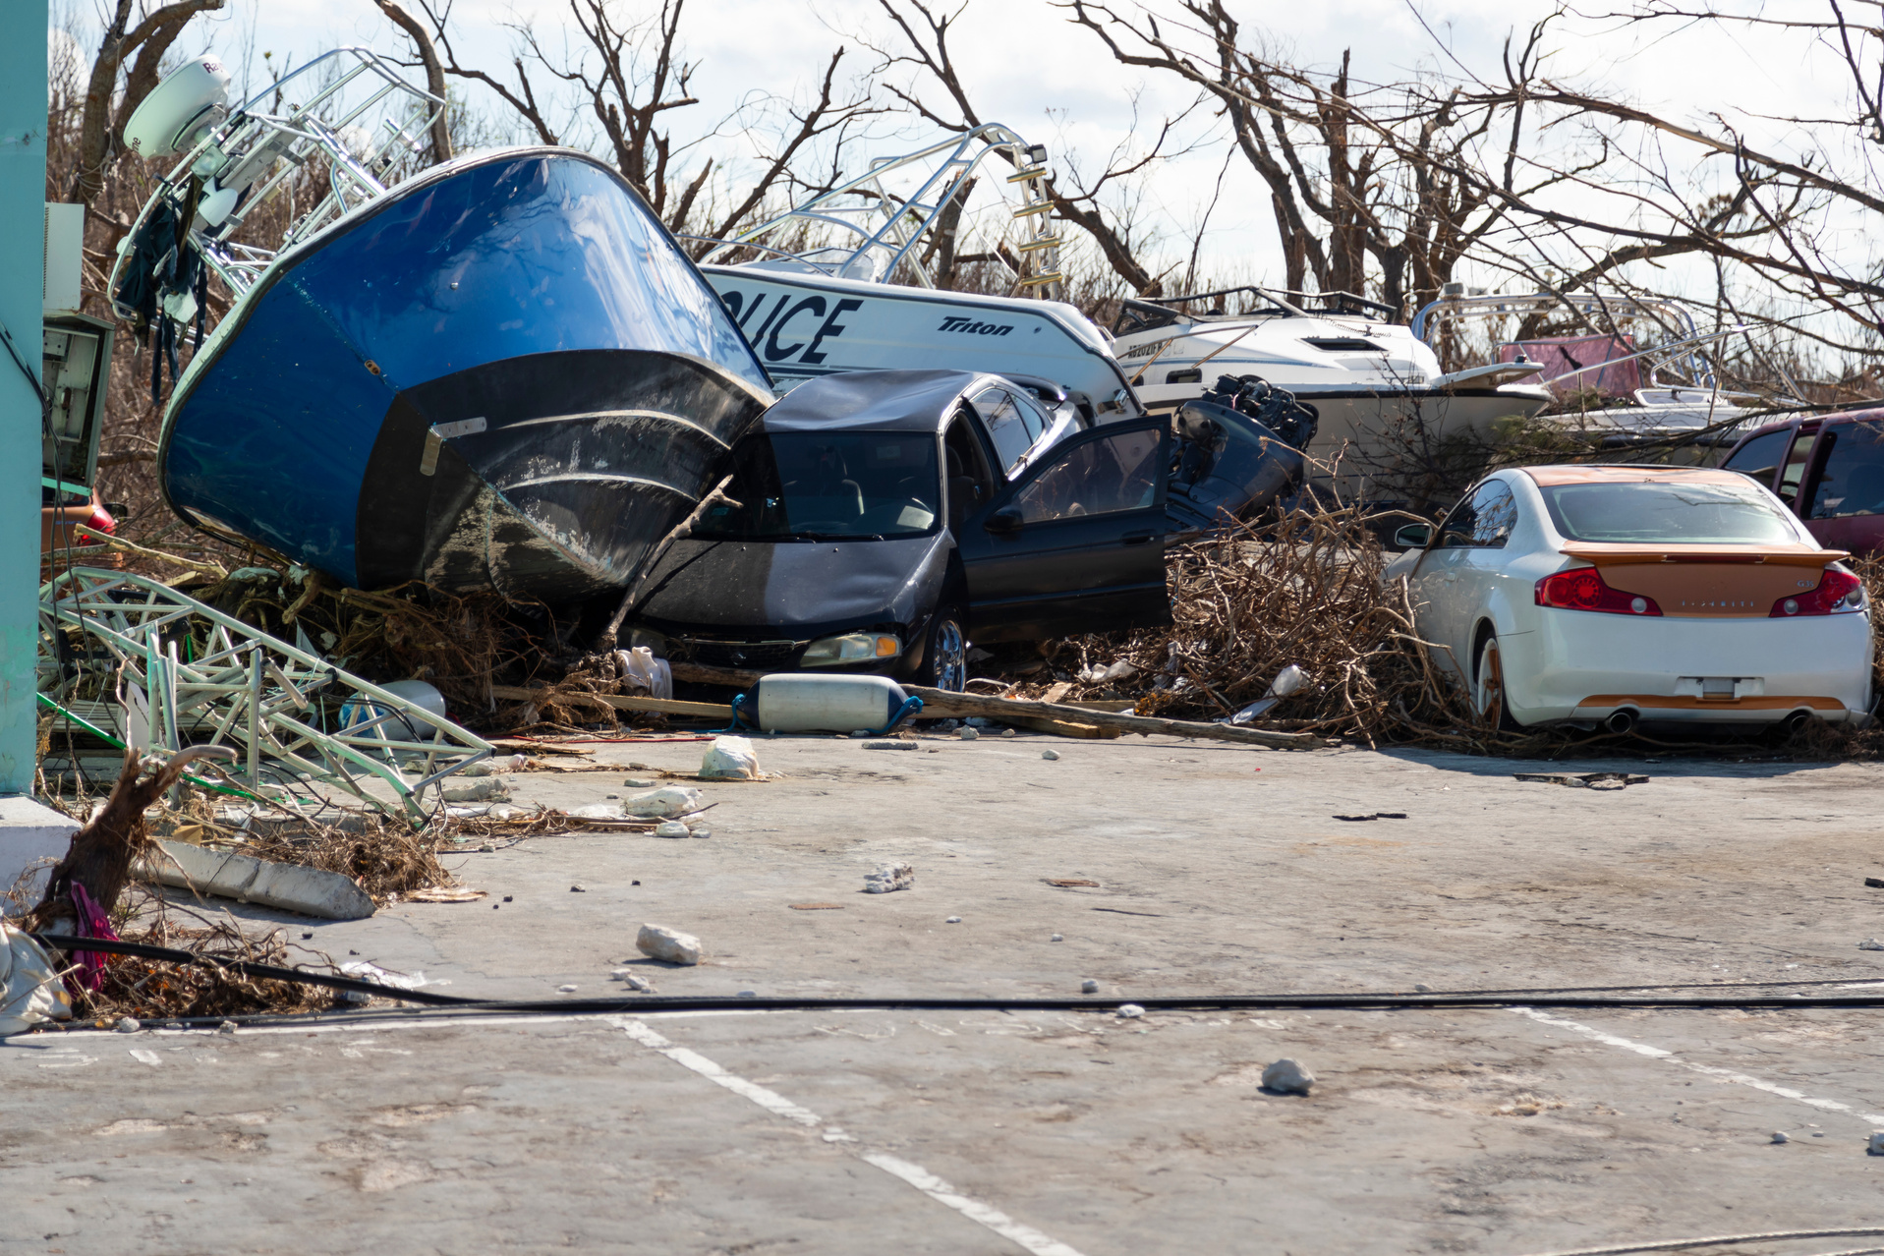
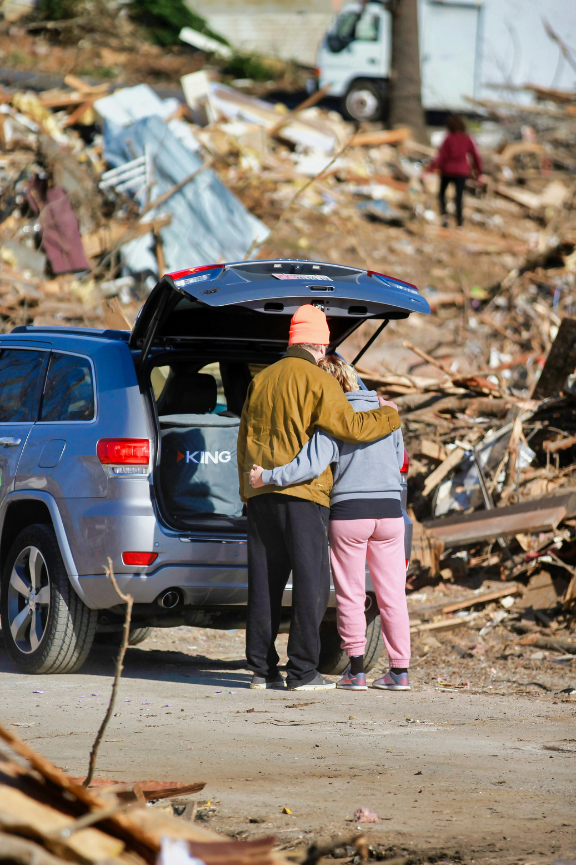
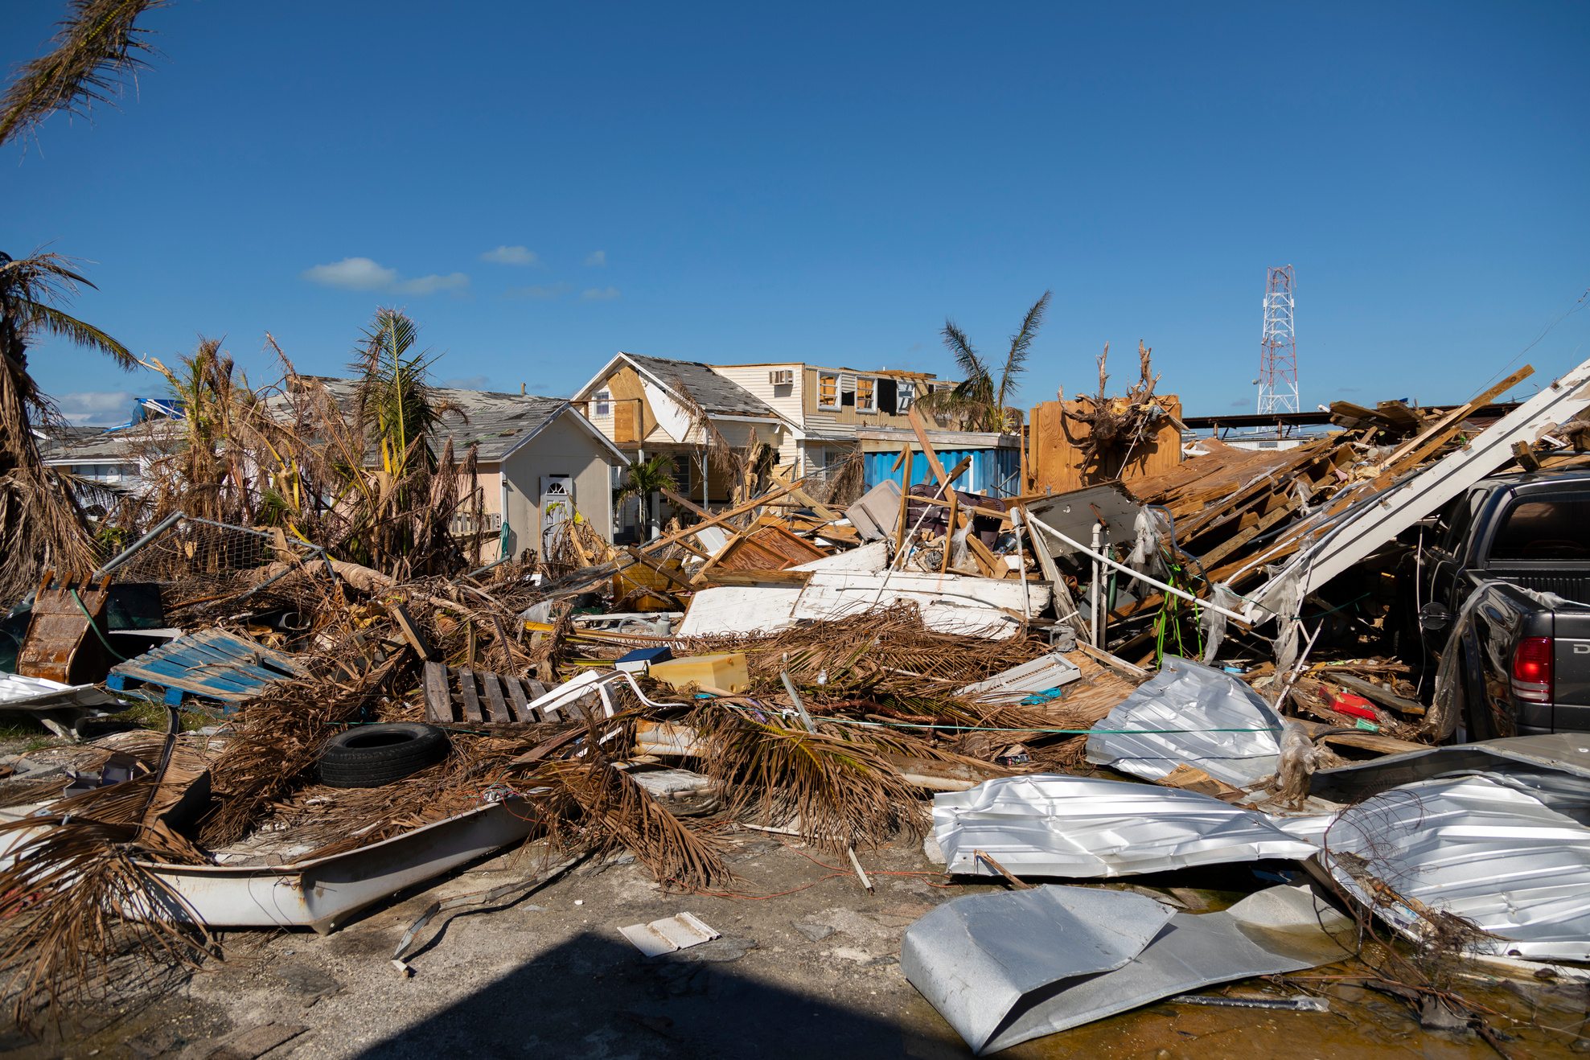
See
Wonder
Know

Slide 12

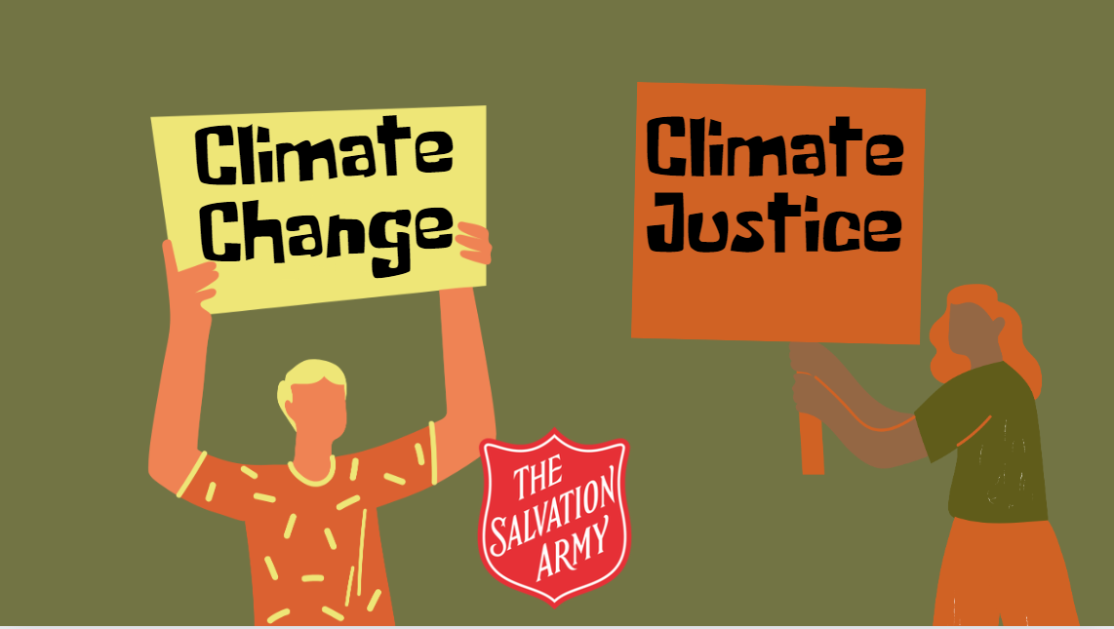
Climate justice

Slide 13


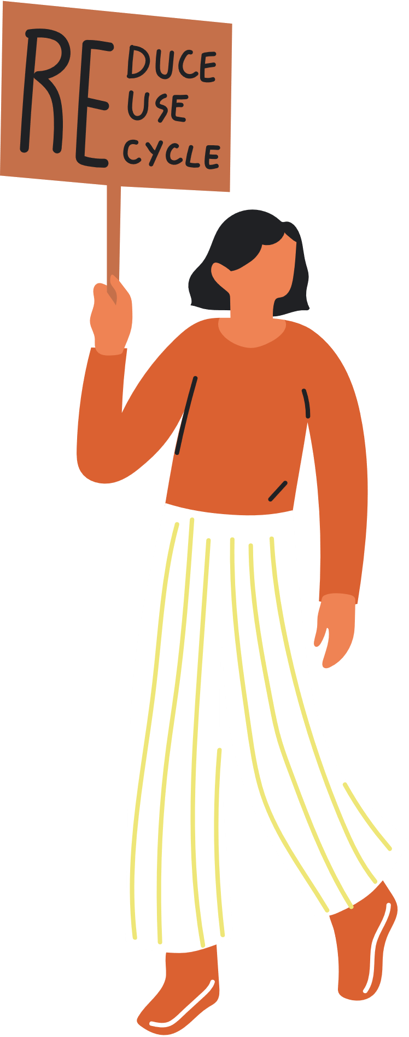

The Bible
Love your neighbour as yourself.
God looked at everything he had made, and it was very good.
The earth and everything in it belongs to the Lord. The world and all its people belong to him.
Which verse do you think is the most important?
God put humans there to farm its land and take care of it.

Slide 14


Activities
Select an activity to explore more.

Slide 15

Hope poster
Give people hope about climate change - that we can change things for the better.
Create a two-sided mini poster.
• On one side write a question or statement about climate change today.
• On the other write a hope for the future.
• Then illustrate.
• Attach string or a lollipop stick so the poster can twirl, showcasing both sides.

Slide 16
Letter
Write a letter about climate change to your MP, councilor or local leader.
• Why do they need to know?
• What do they need to do?
• Share how you feel about climate change.
Write a letter to the planet.
• Explain what is happening to the planet.
• Give hope to the planet that action is being taken.

Slide 17
Poem
Ideas to base your poem on:
• Fairness for the world
• Your hope for the future
• Reduce, reuse, recycle and rally

Slide 18
Reminder notes
Create small notes to help remind people to reduce, reuse or recycle.
• Be clear what you want people to do eg turn off a light, put items in correct bins, reuse an item.
• Make the reminder clear and noticeable.
• Plan where to put them so they are noticed.

Slide 19
Plan
Create a plan to stop climate change.
How would YOU change the world?
Think BIG - and small.
• How would you stop climate change?
• How would you change the world for the better?
• Plan out your ideas to revolutionise the world.

Slide 20
Research
What can you find out about...
Reduce, reuse and recycle
Climate change
The Salvation Army

Slide 21
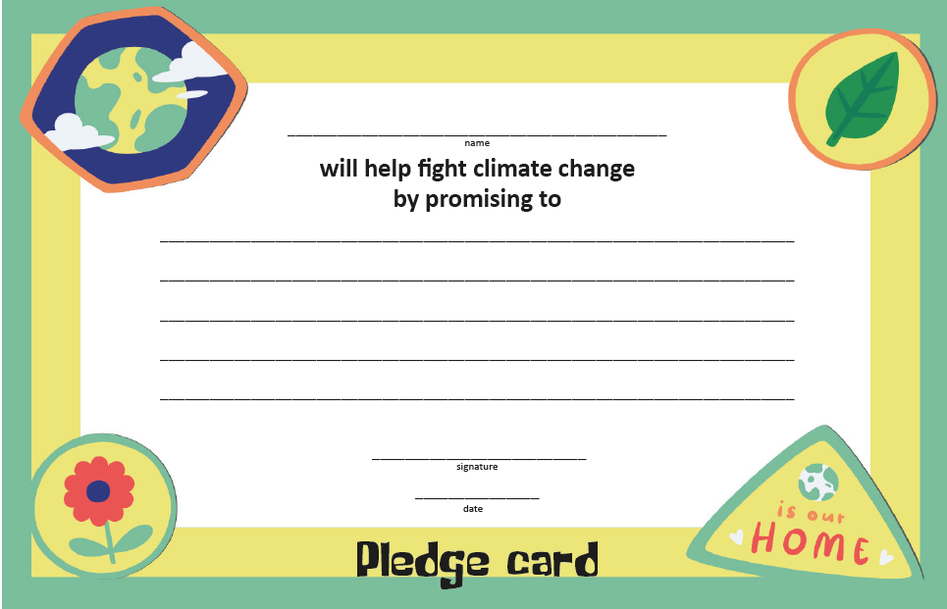
Pledge card
What will you do to make a difference for the planet?

Slide 22


What have you learned?
Tell me one thing...
About the impact of climate change on communities around the world
How The Salvation Army is helping to fight against climate change
1
You are going to do to help prevent climate change
You are going to tell others about what you have learned today

Slide 23





Slide 24
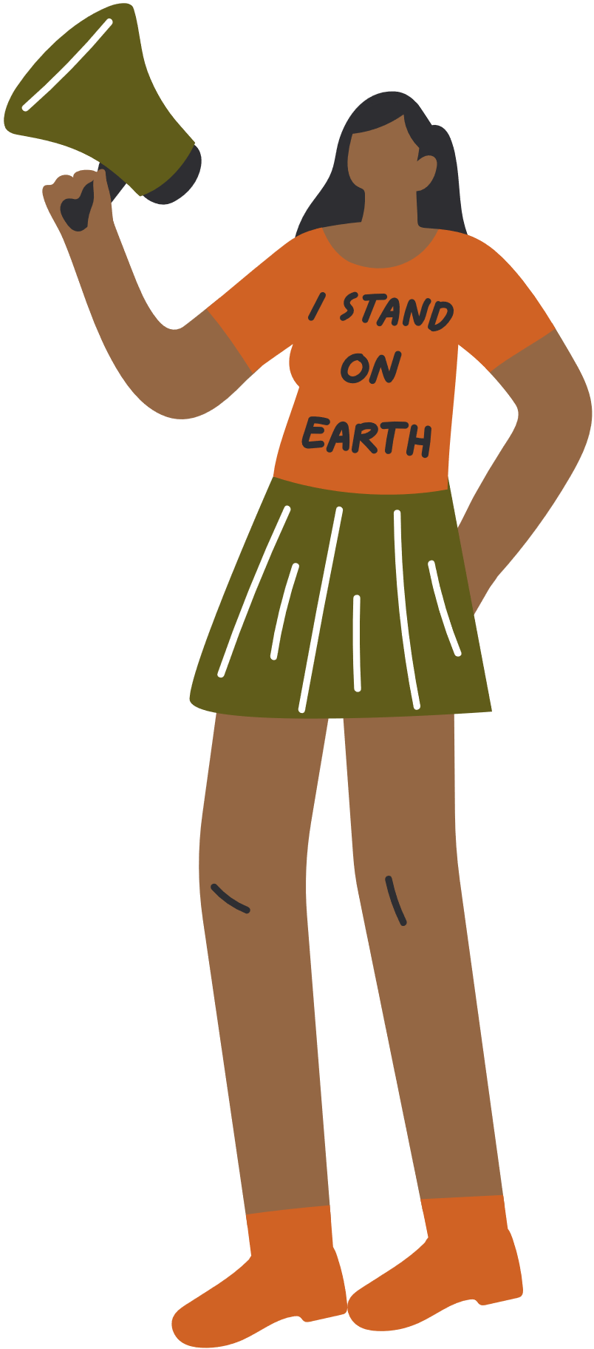
Climate Change
Climate Justice

