Slide 1
Week Five

Slide 2
Insert video here
Notes:
The Self-Denial 2025 videos can be found at https://www.salvationist.org.uk/resources/key-dates/self-denial-resources

Slide 3
Action Prayer
Father God,
Keep us rooted to you Lord. May our relationship with you go deeper.
2. By talking to you in prayer,
3. And being faithful to your word,
4. Teach us to grow in our knowledge,
5. Strength
6. And love
7. To actively serve our community in your name.
Amen.
Notes:
Teach your congregation actions to the prayer on the screen.
Hands down and fingers spread apart like roots.
Hands in praying position.
Open hands to make a book.
Point hands to head.
Strong arms.
Hands in a heart shape.
Open arms.

Slide 4
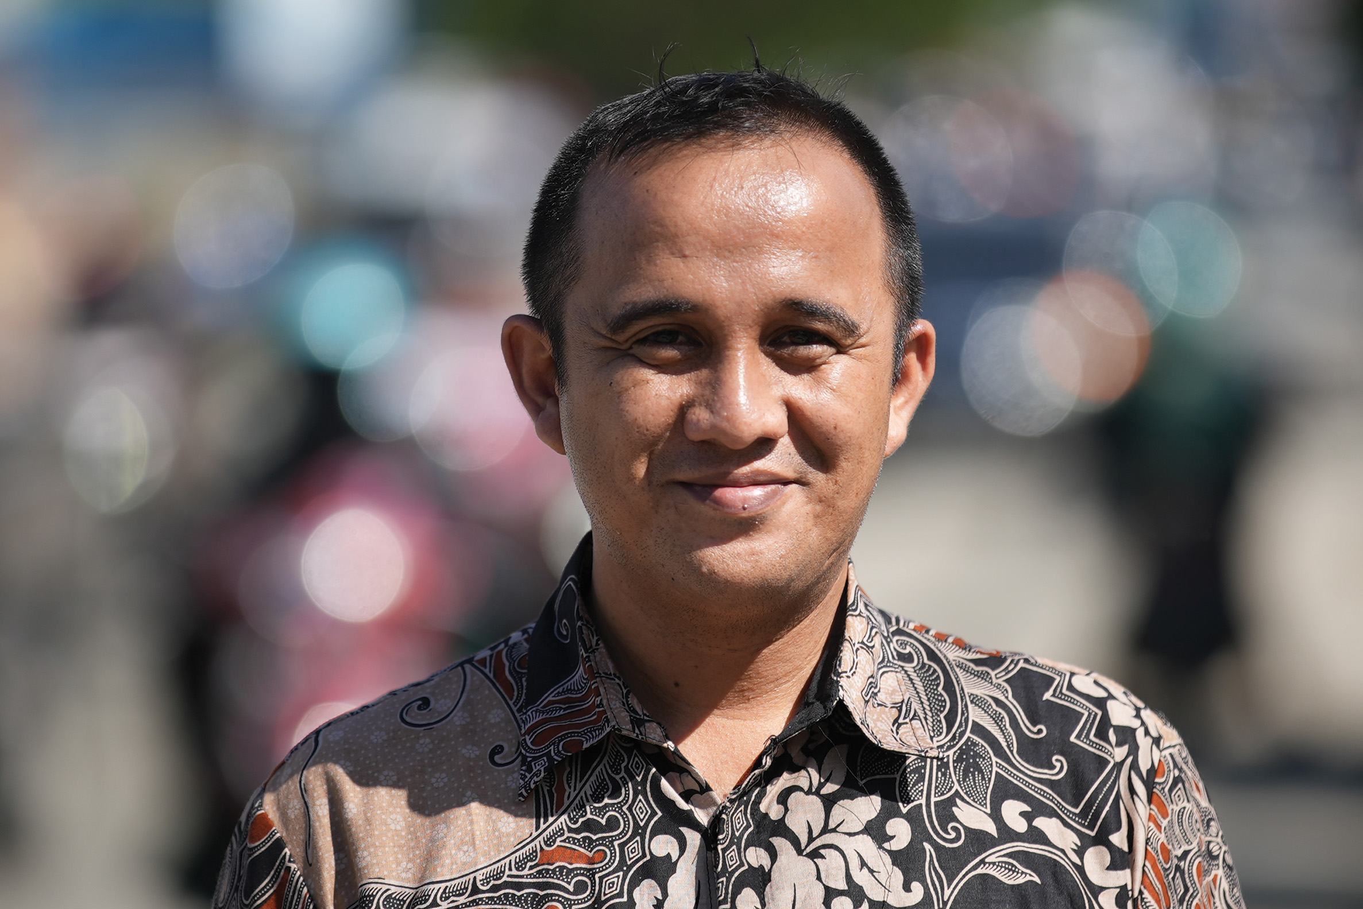
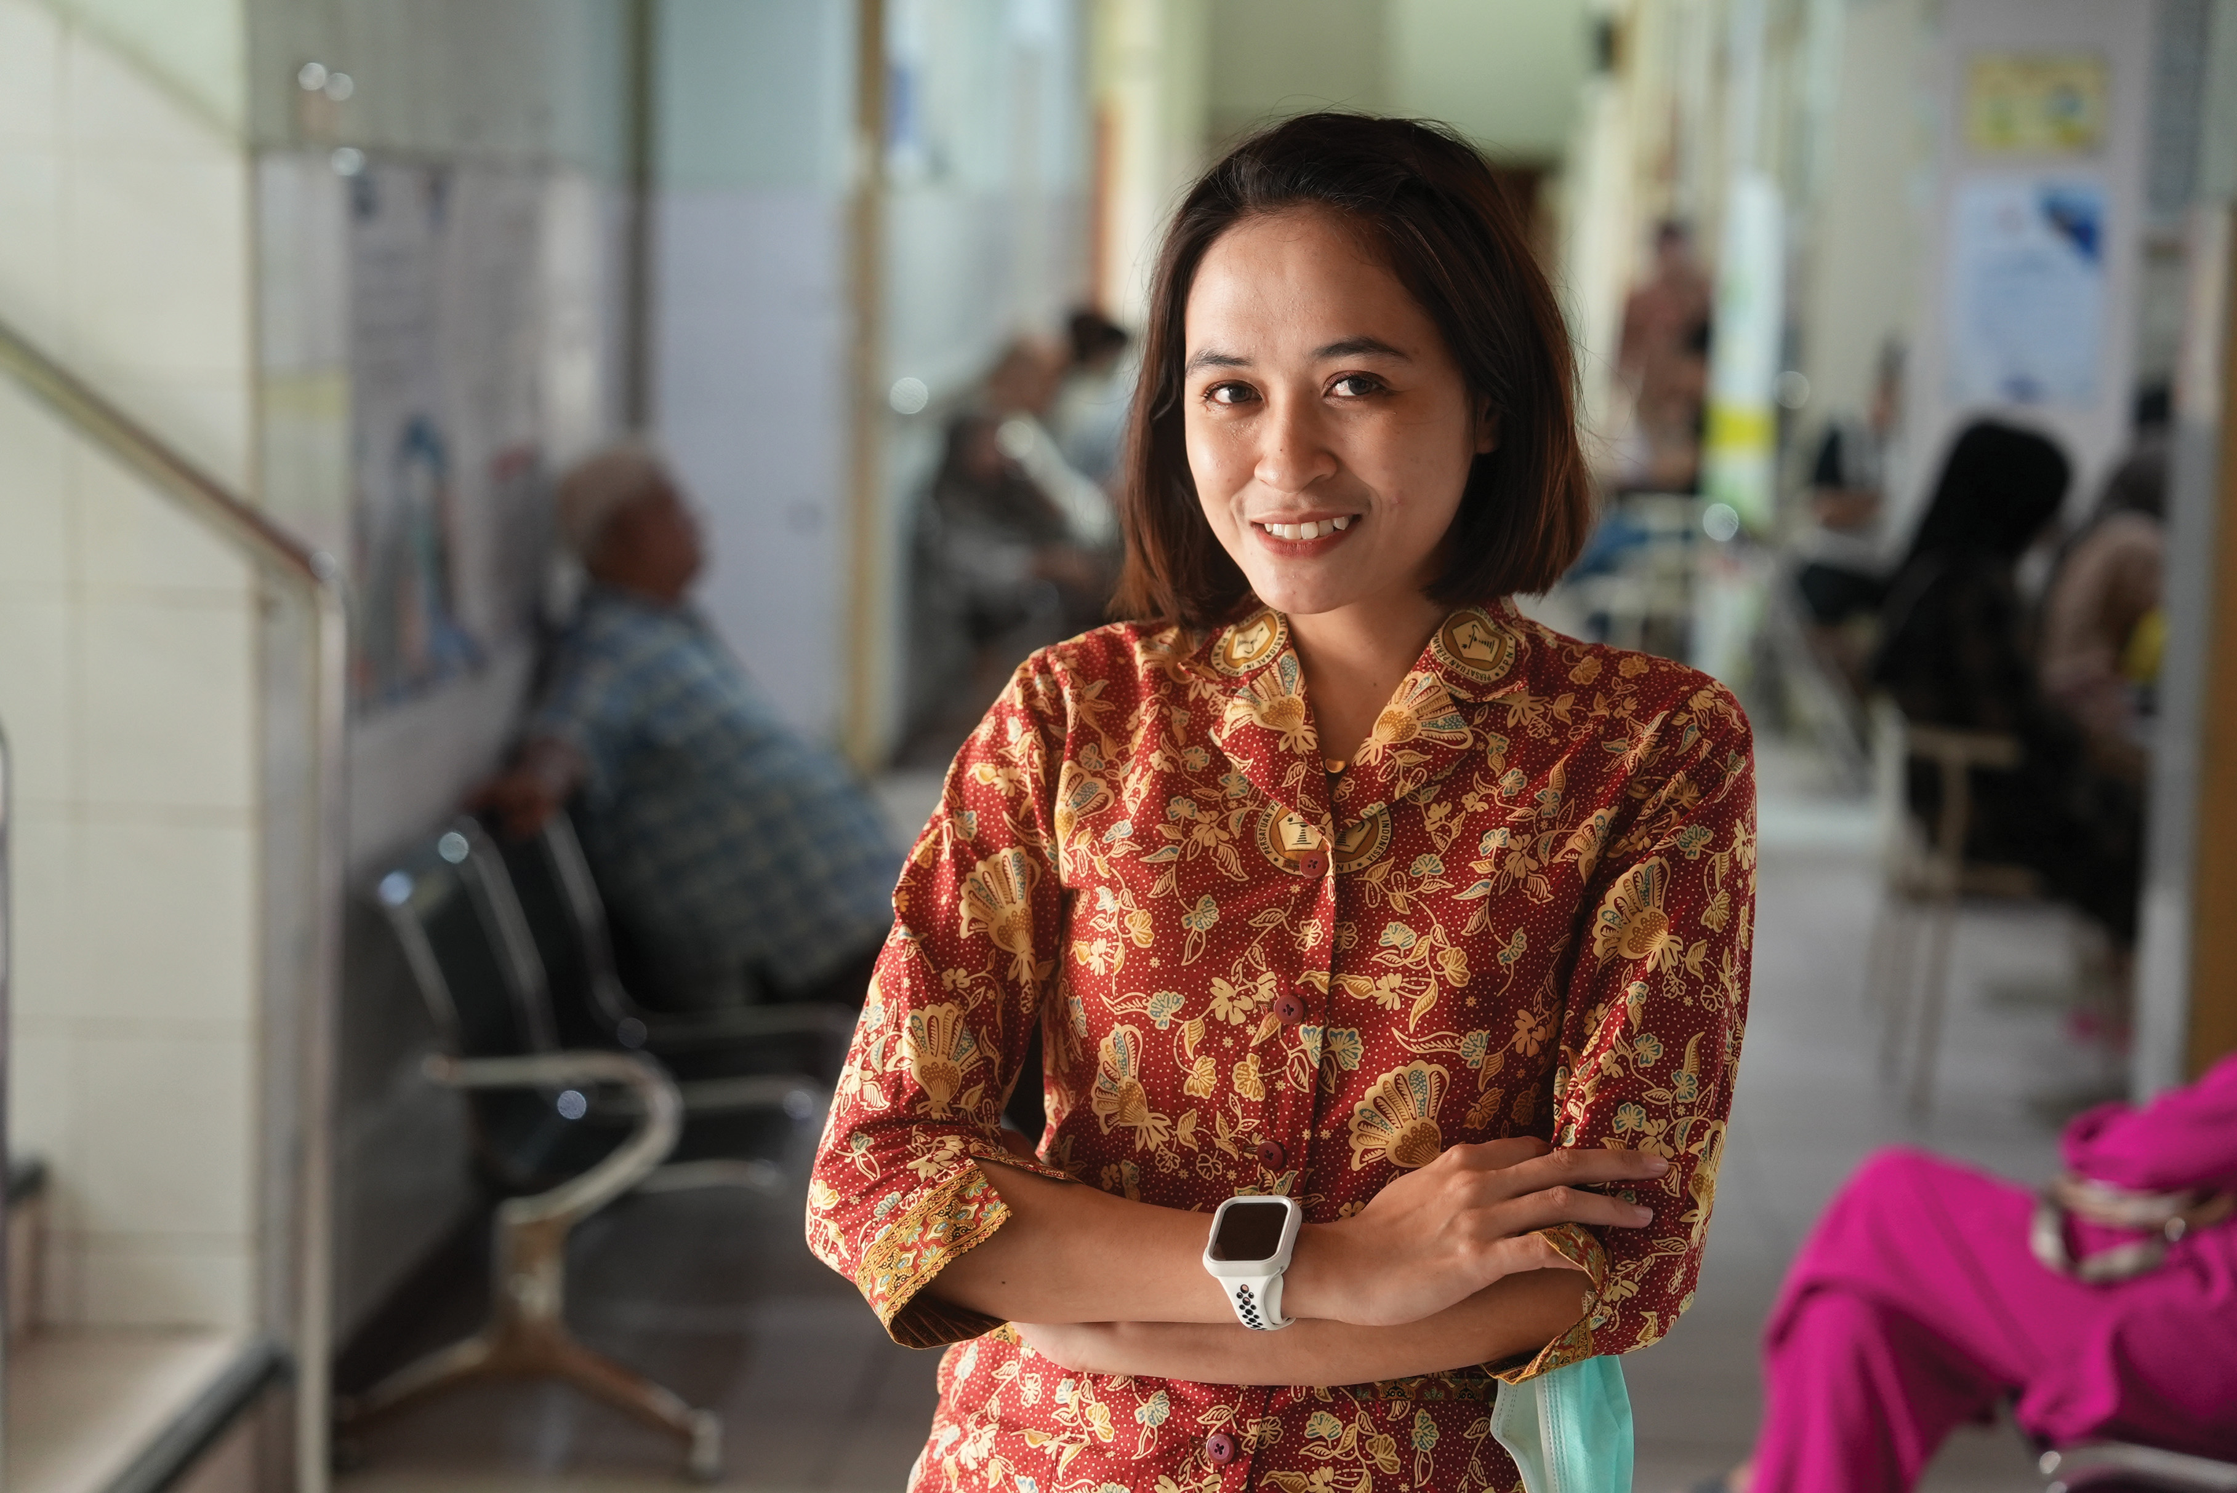
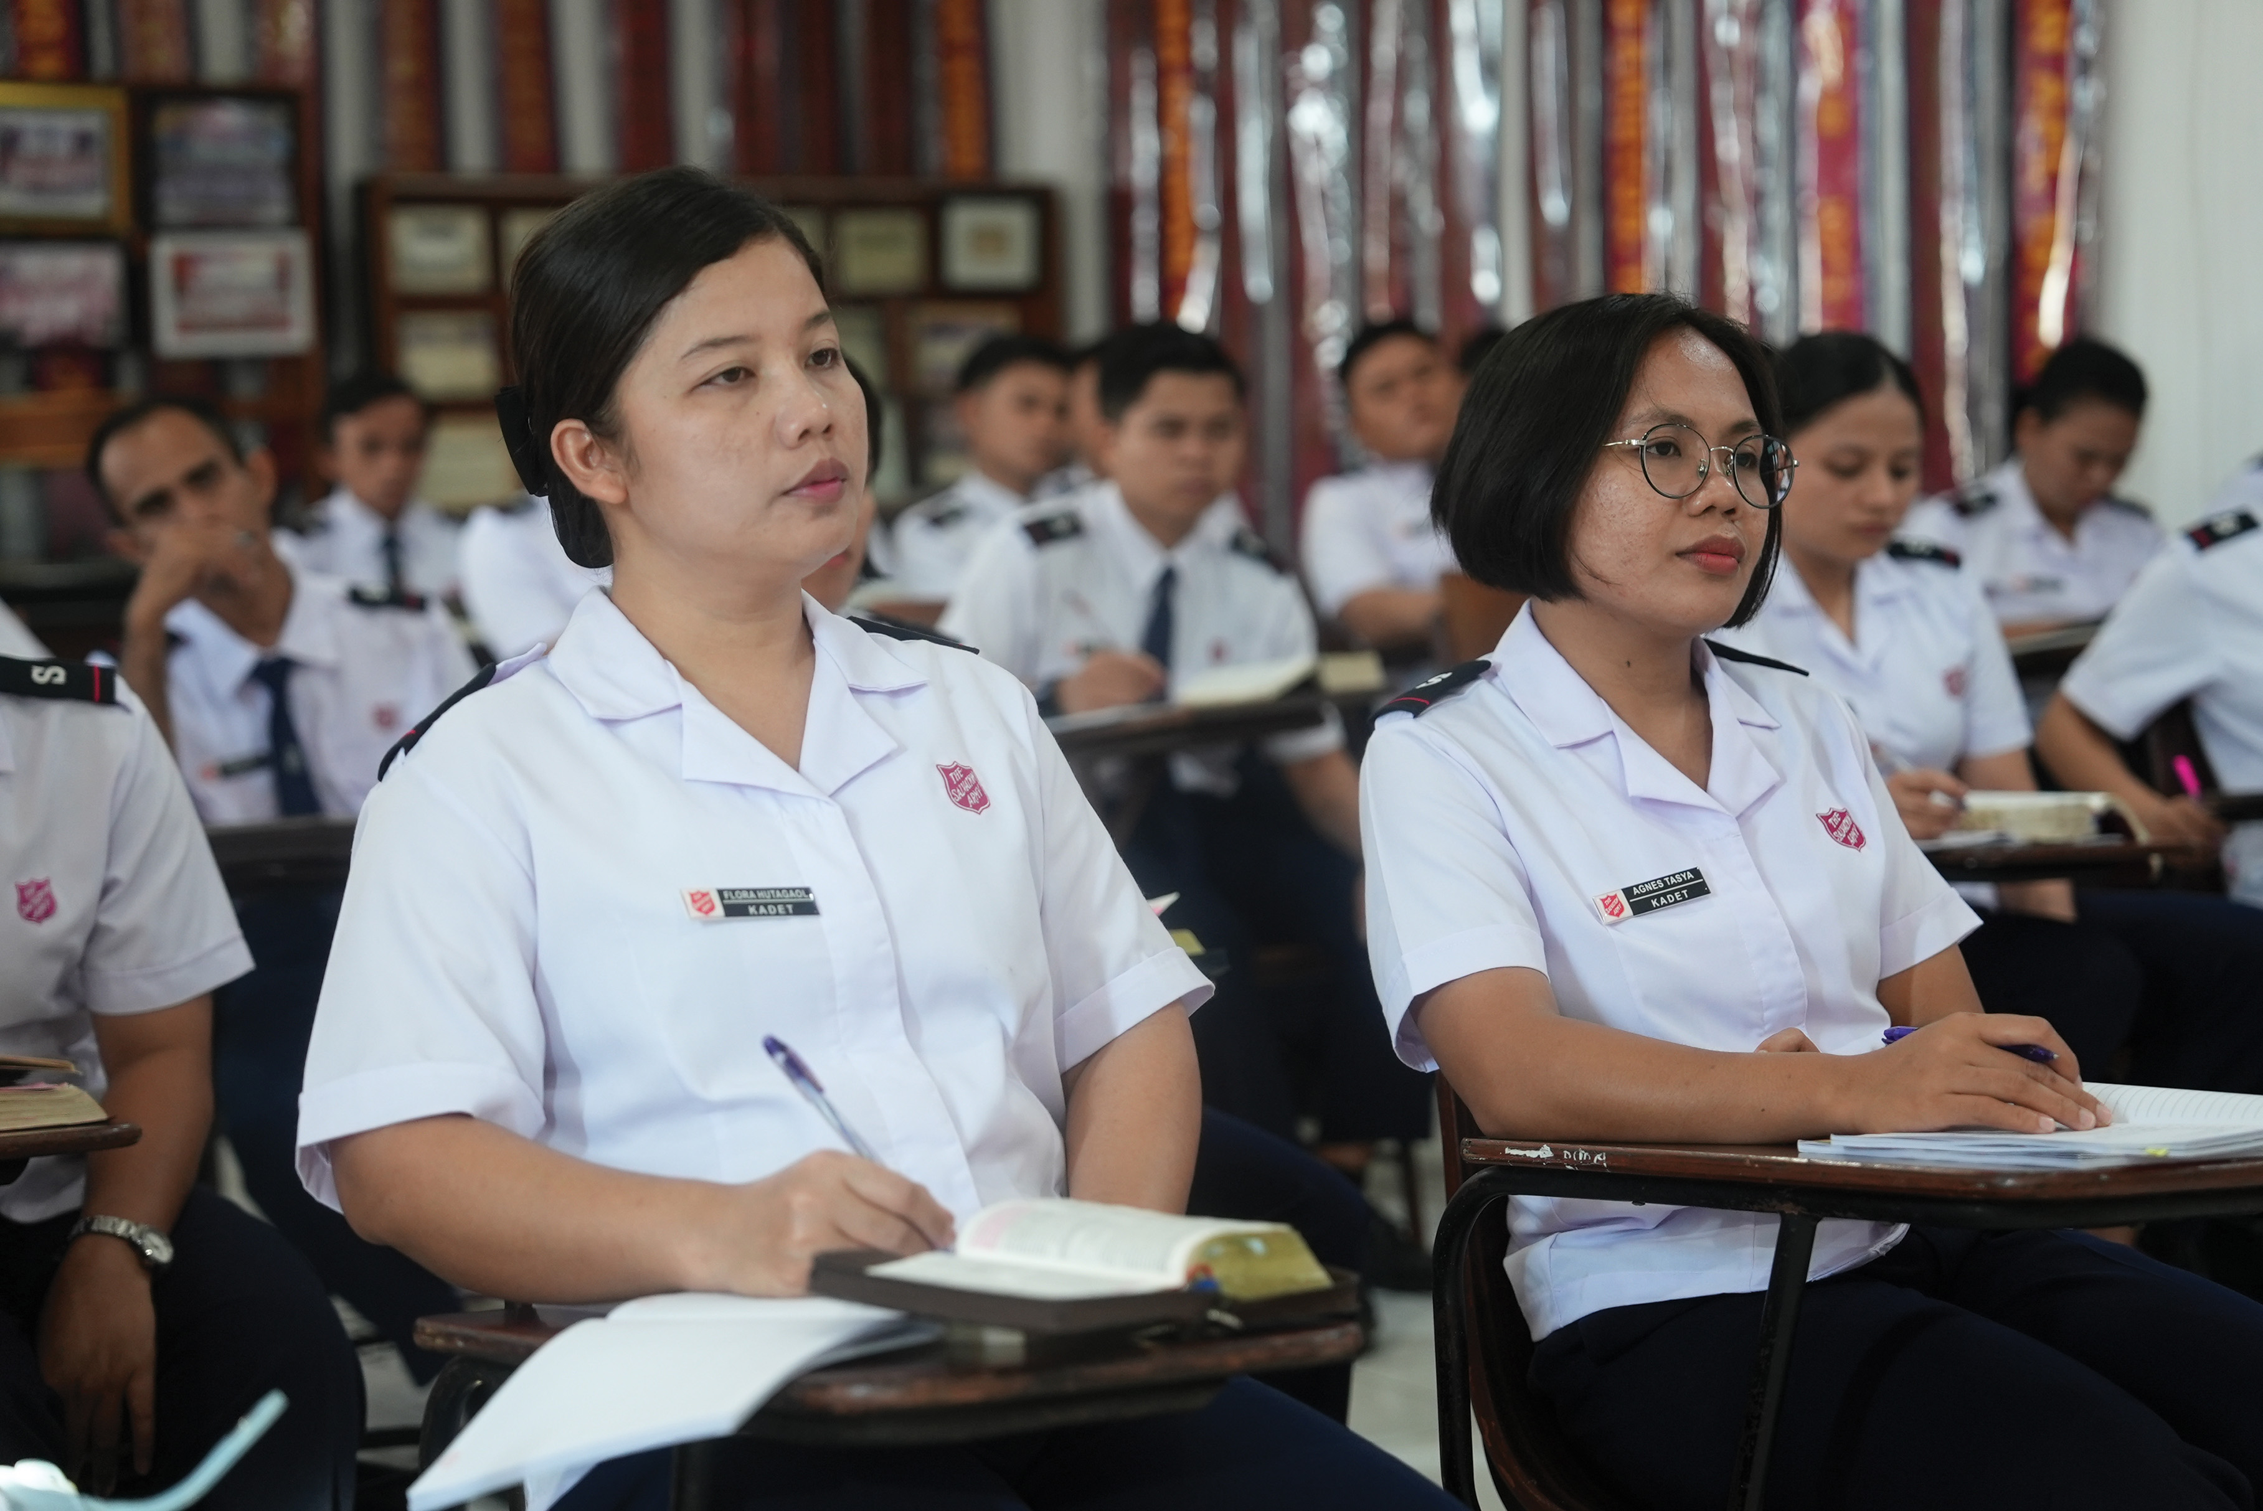
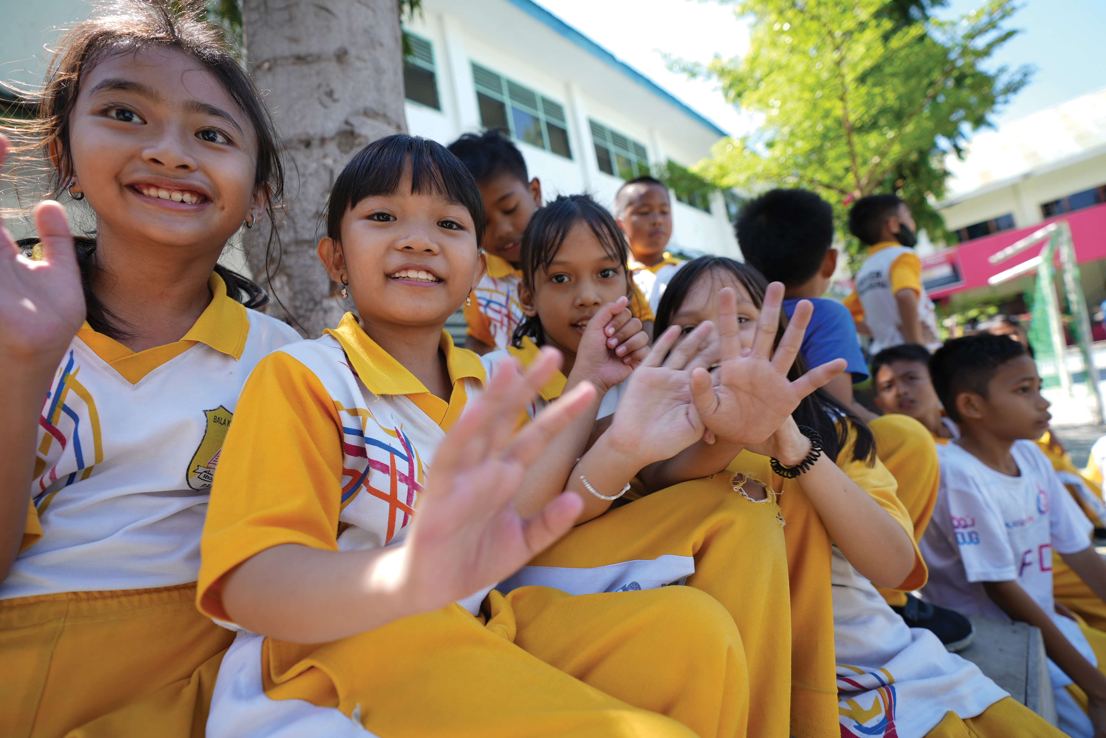
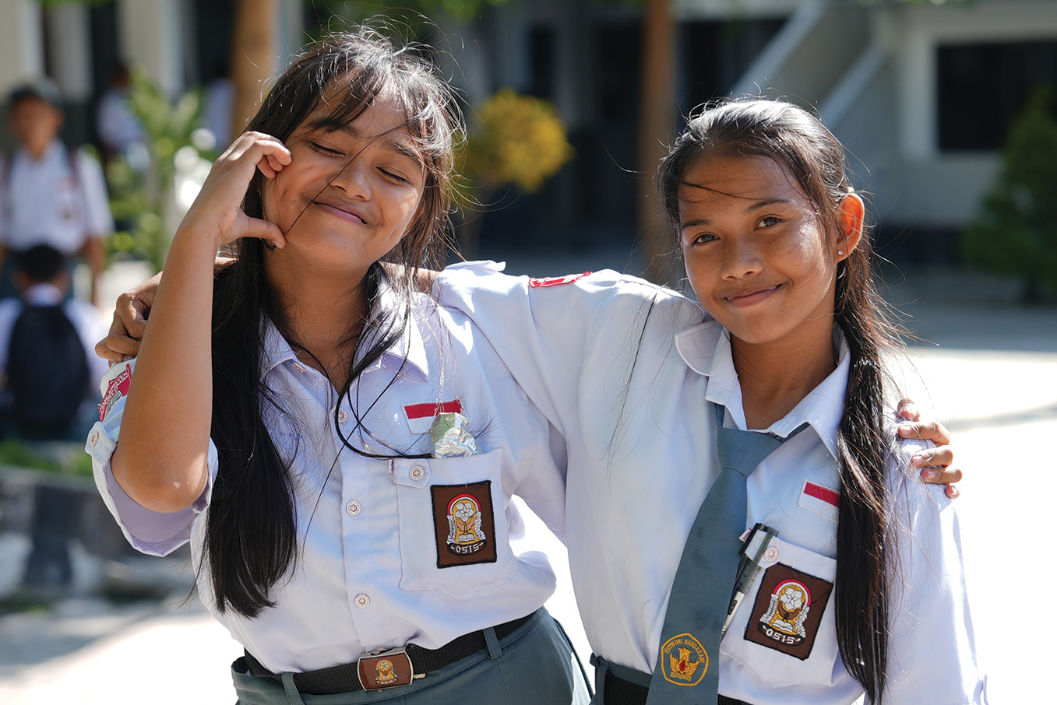
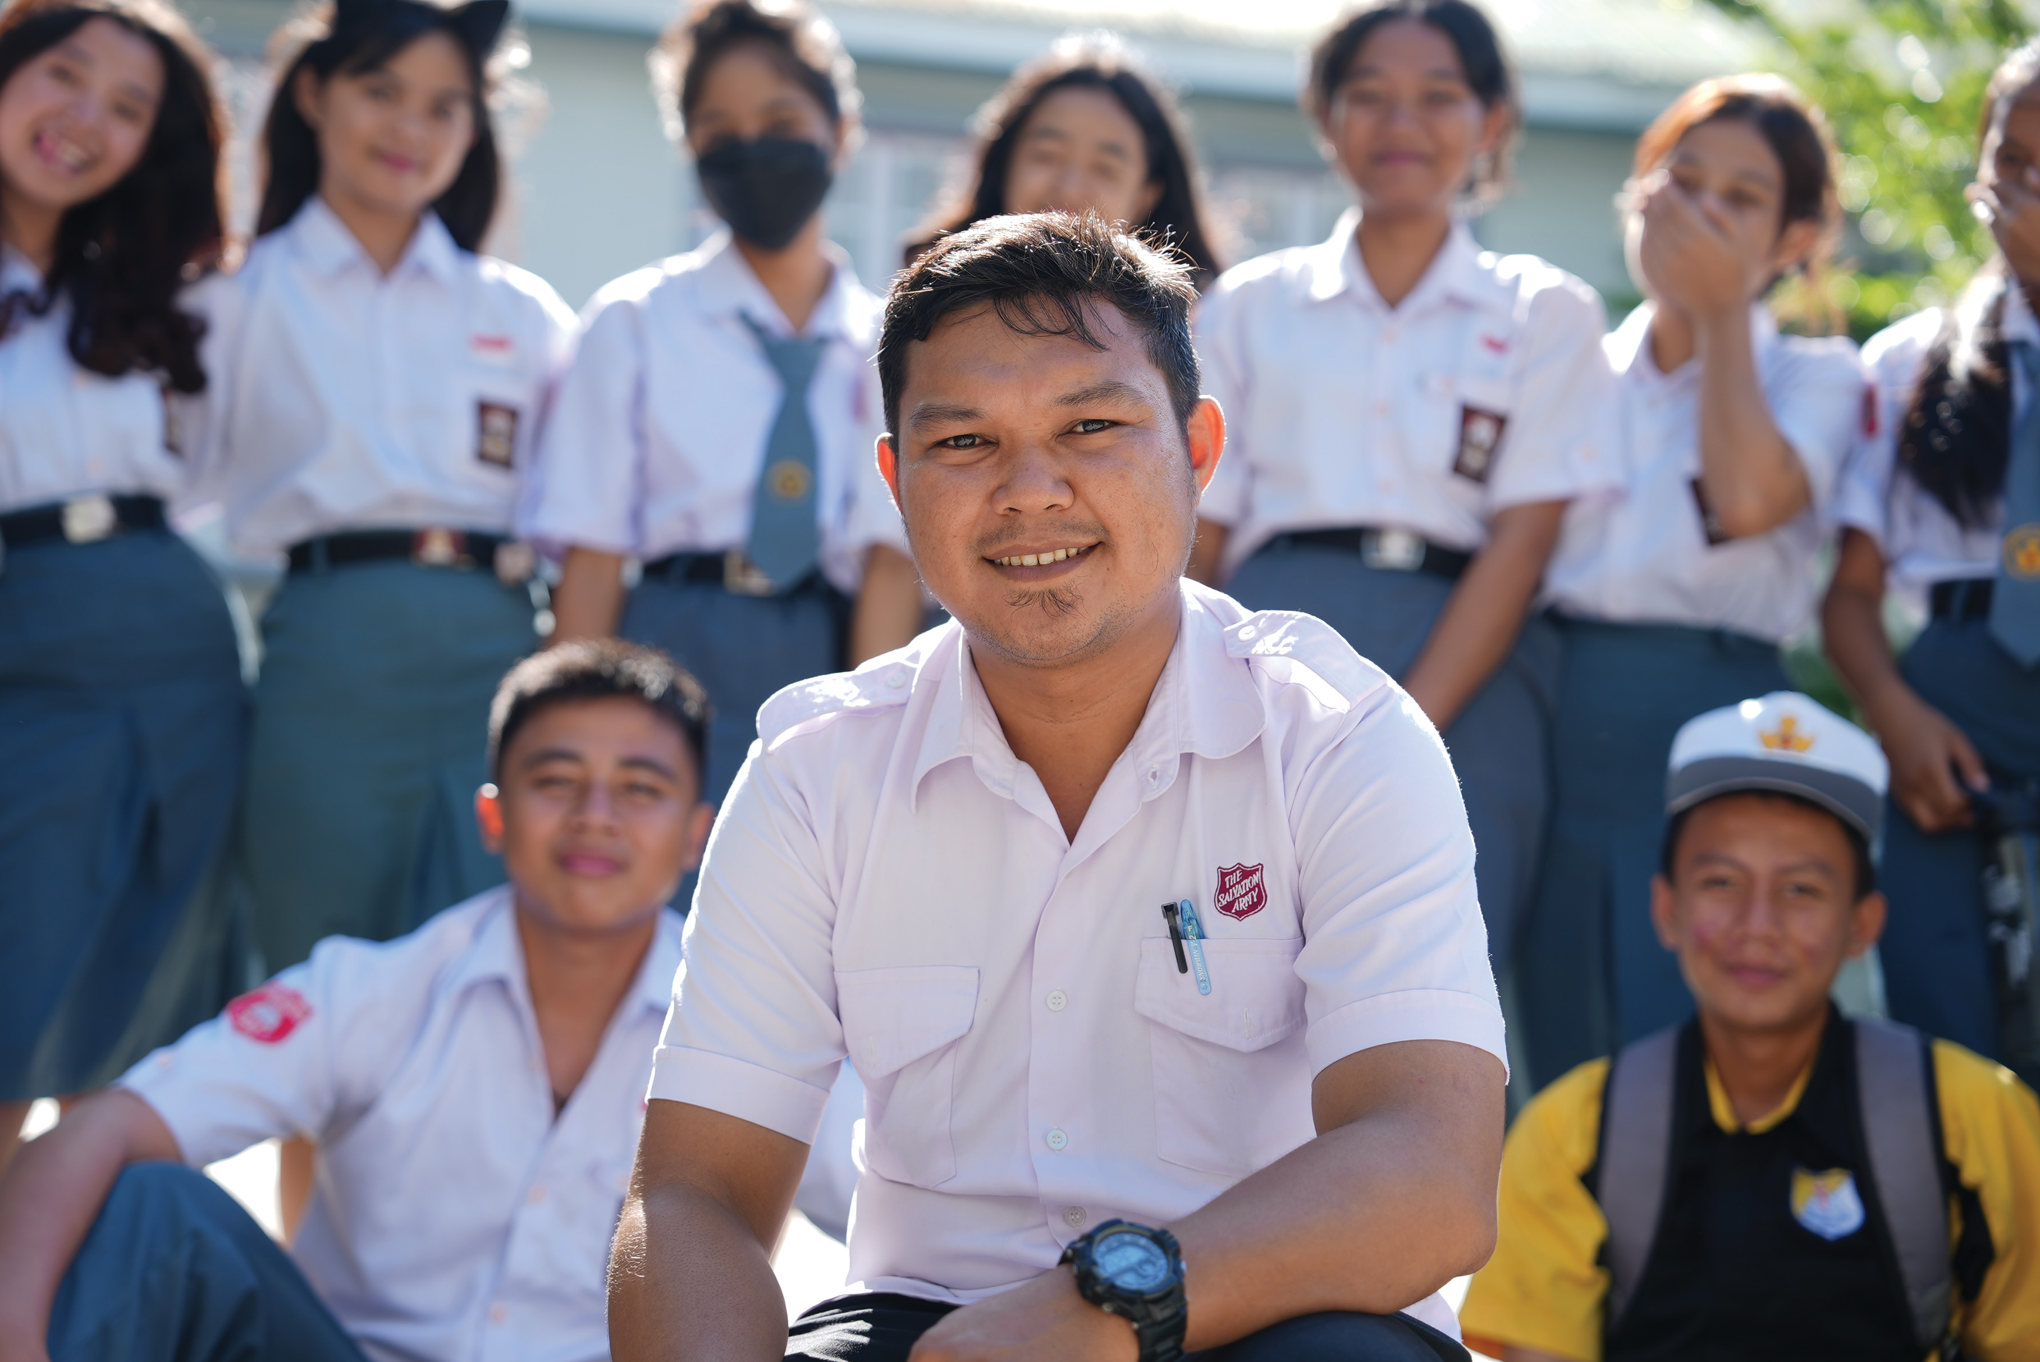
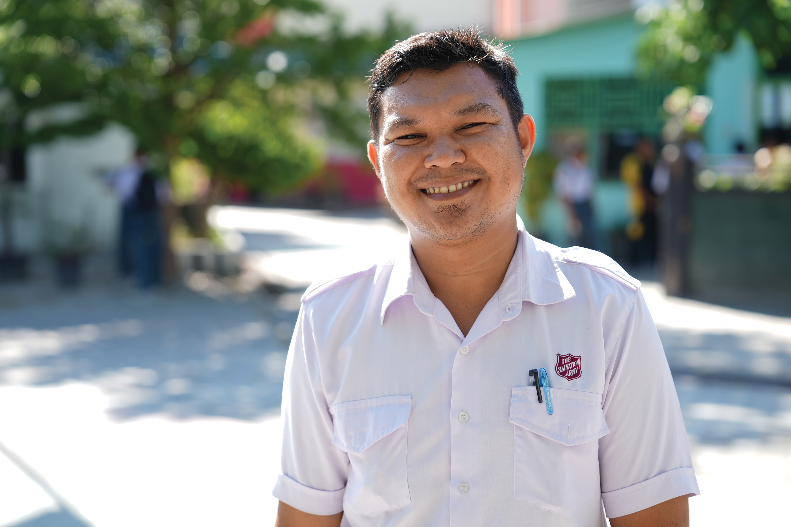
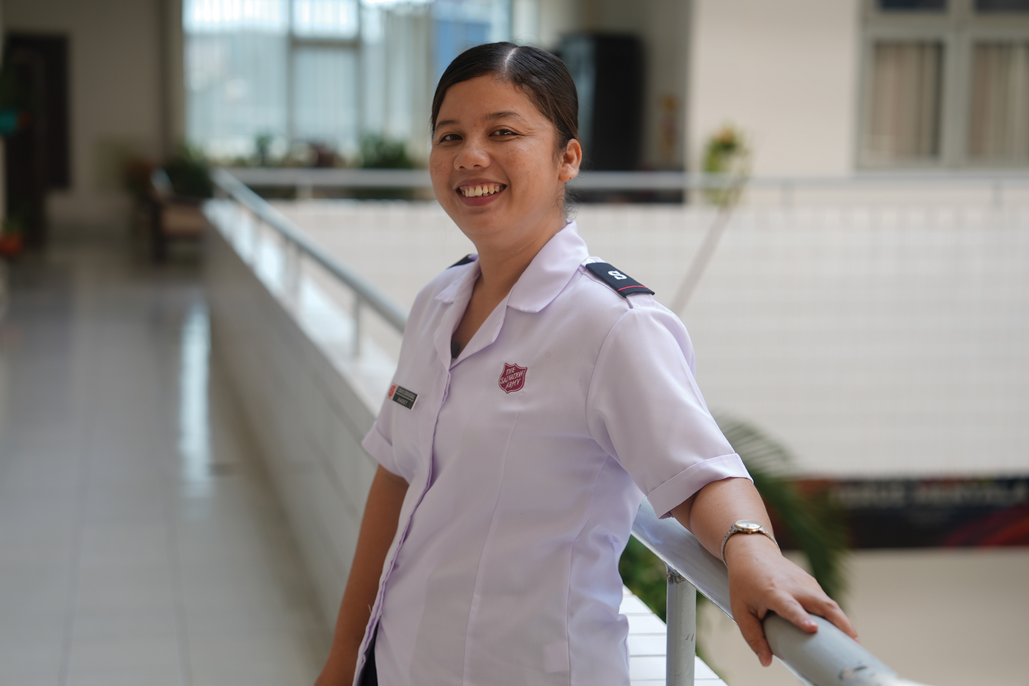
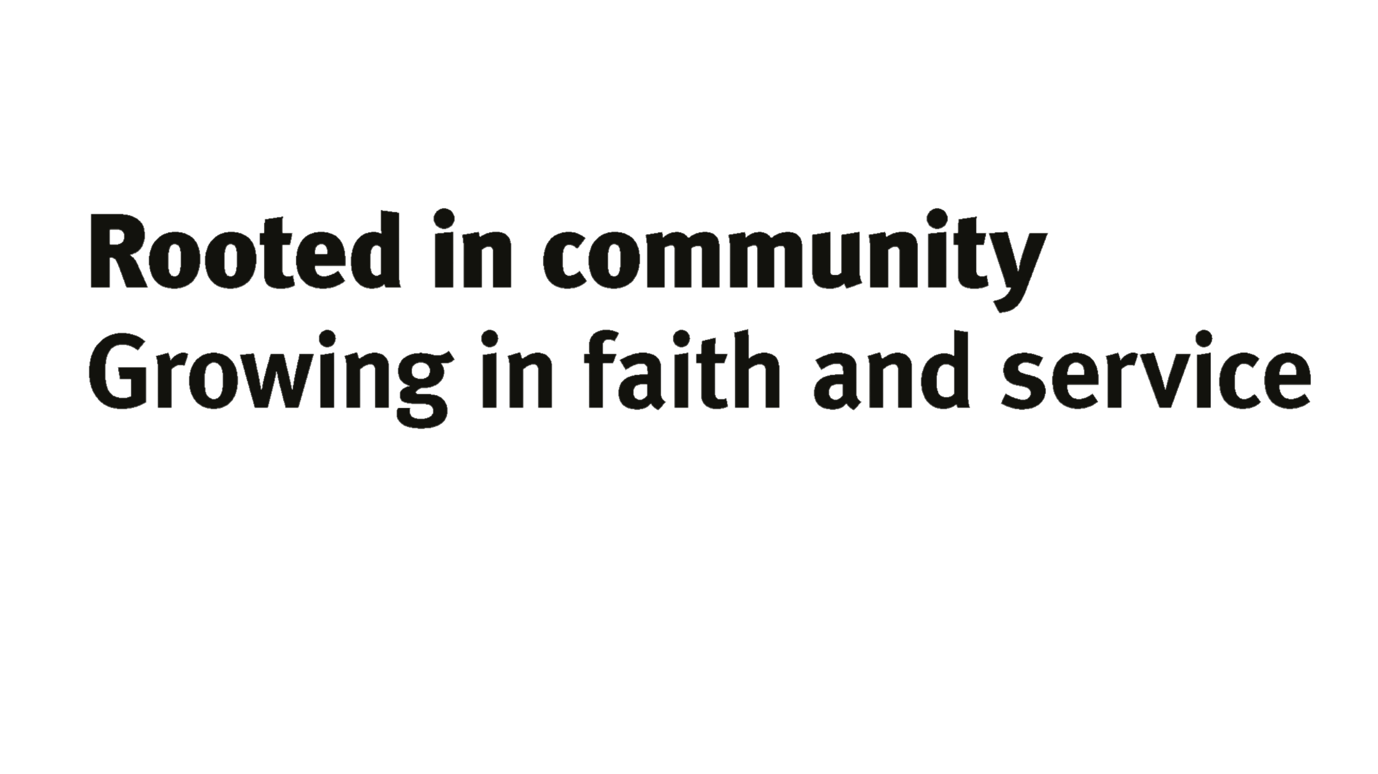
Self-Denial Appeal 2025
Scan the QR code to give now!
Notes:
Alter Service
On the screen there are a selection of images taken from the stories of people we have met over the last five weeks. As we give our financial offering, display the images on screen as a visual reminder of the impact of our money.

