Slide 1
Week Four

Slide 2
Insert video here
Notes:
The Self-Denial 2025 videos can be found at https://www.salvationist.org.uk/resources/key-dates/self-denial-resources

Slide 3
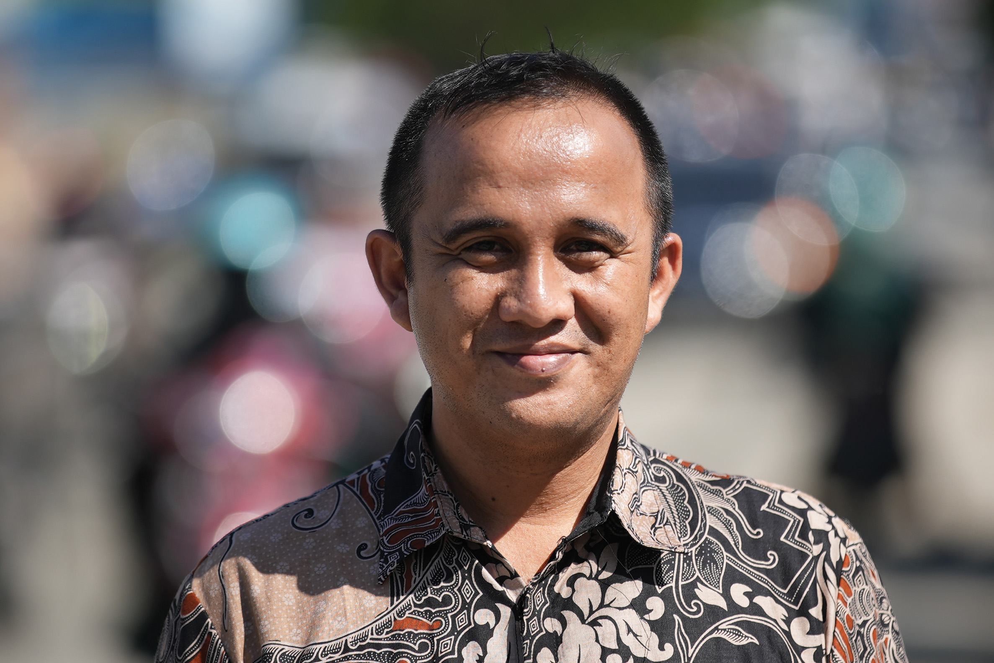
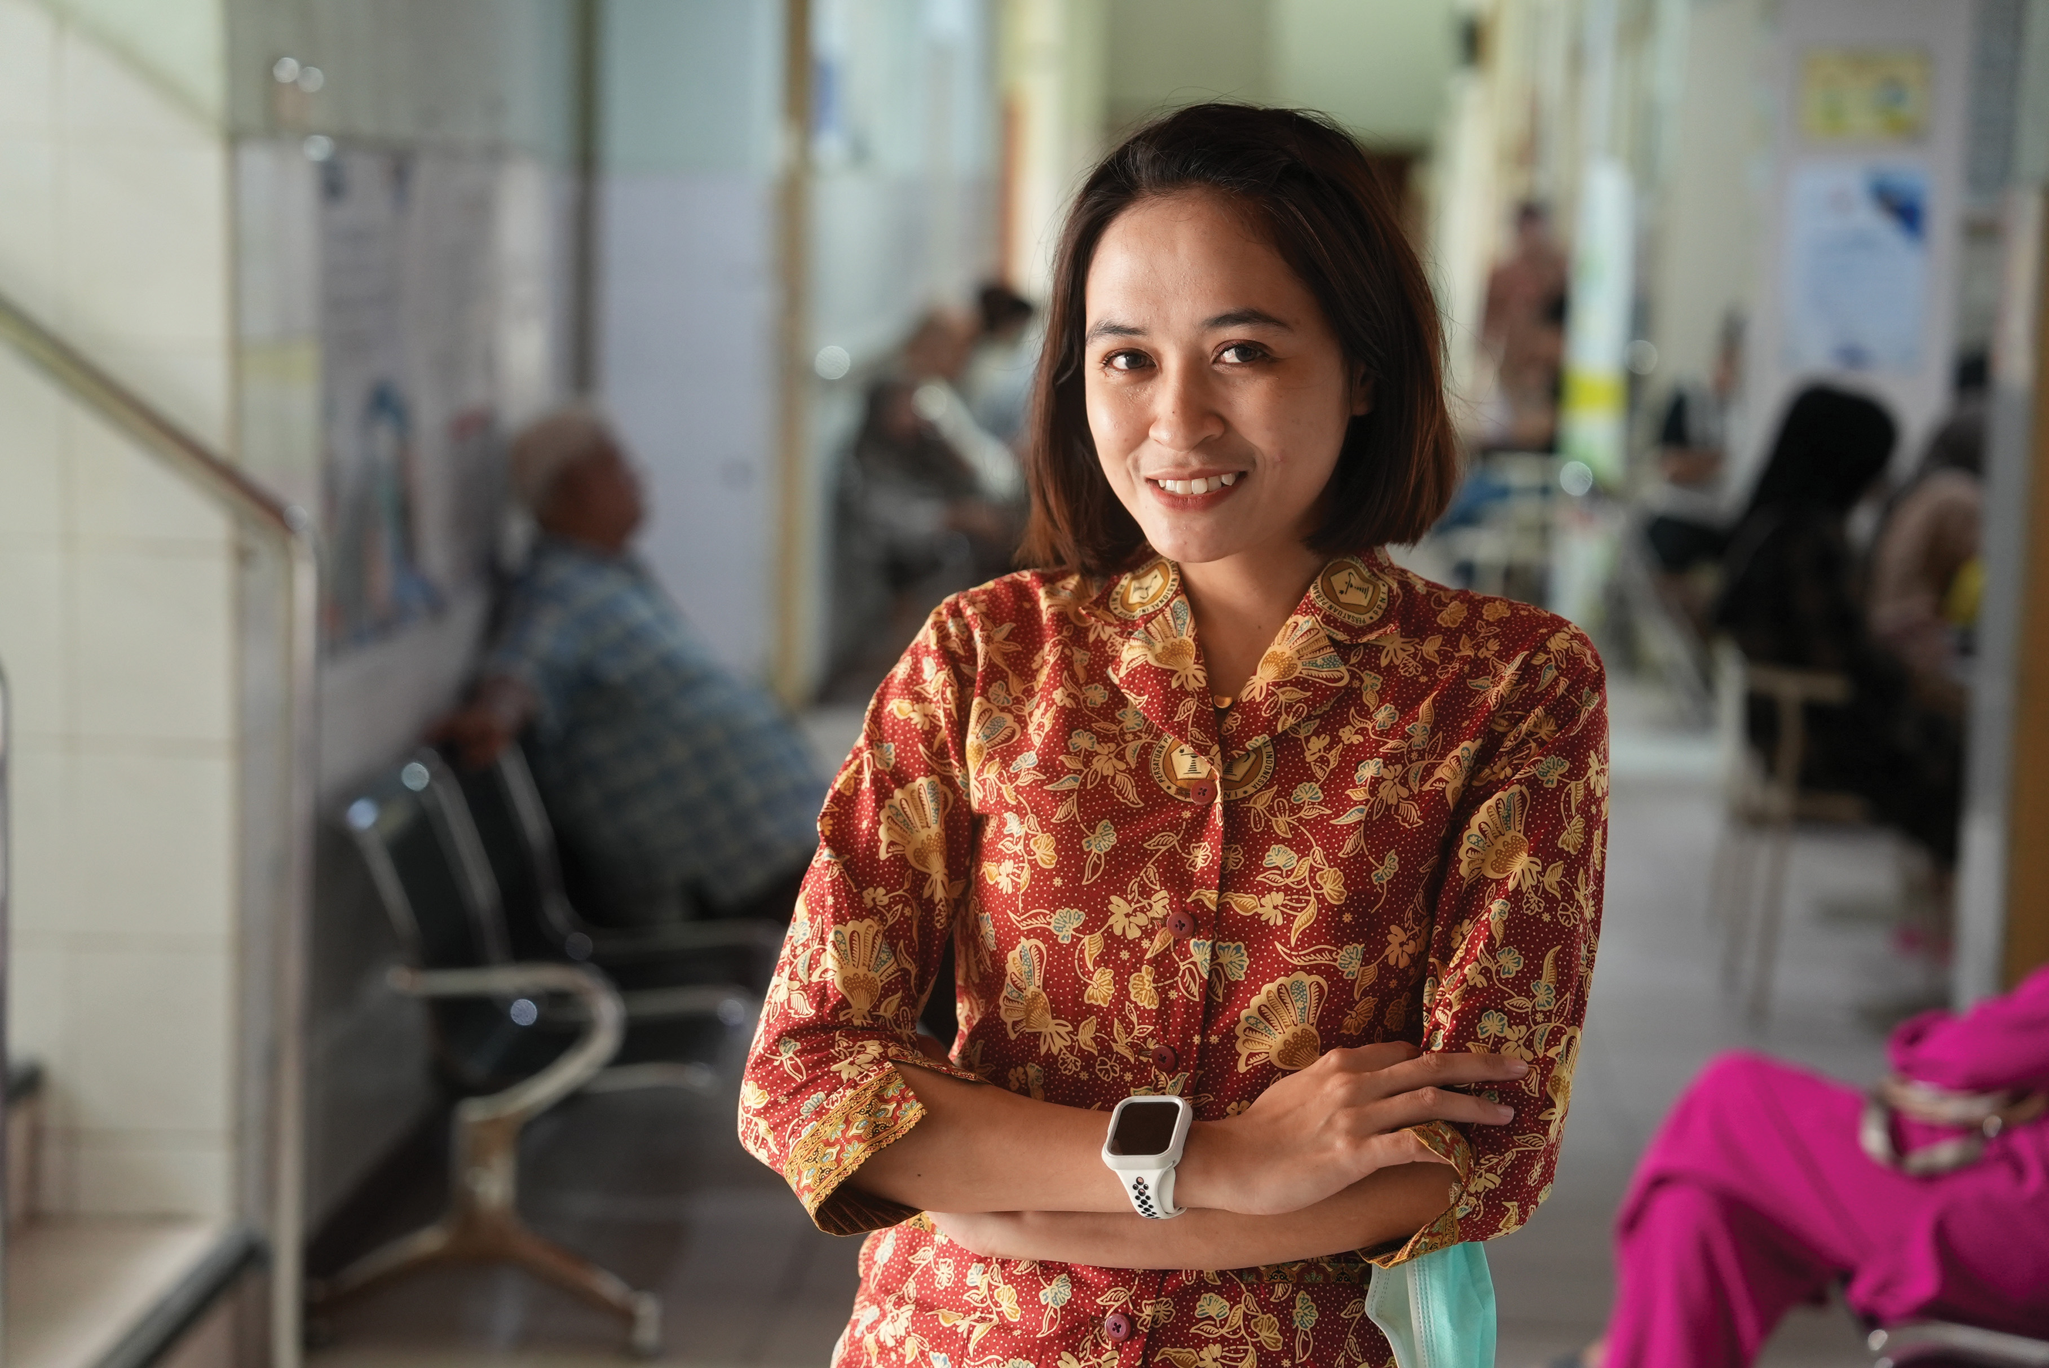
Dita Rossela, nurse at Woodward Hospital
Self-Denial Video Week Four
‘We don’t give because we have a lot or because we want people to know that we often give to others, but giving is an action that God has taught us.’
Notes:
In this week's video, it emphasises this year’s themes to both be growing in faith and social action. It is important as we approach the final week of the Appeal, we understand what it means to do both. Spend some time reflecting on the quote on the screen. Below are some questions to prompt this time of reflection:
What does this quote look like for you?
How can we begin/continue to give of our time, talents and financially in this community?
In 2025, is there more you could be doing or perhaps a change in direction?

Slide 4
Prayer Points
1.5 million patients supported by Salvation Army hospitals each year.
Salvation Army schools educate over half a million students in 3,000 schools around the world.
Healthcare and education professionals employed to provide care and support.
Notes:
On the slide there is a list of people mentioned in the video who benefit from The Salvation Army being rooted in communities around the world. Take time to pray for the health, minds and spiritual life of each of the groups listed.

