Slide 1
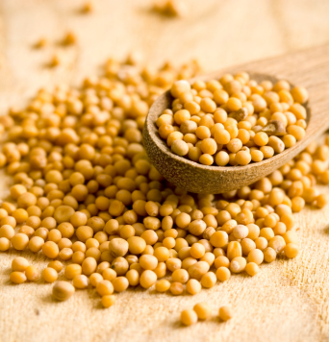
Mustard
seed
National Month of Prayer for Parent and Toddler Groups
JUNE 2024

Slide 2
Our Father God…
We thank you that we are all created in your image and are loved by you. May this truth be lived out in our toddler groups as we seek to show and tell of your love. May our toddler groups be places of belonging and safety where families can come as they are.
I commit to praying for parent-and-toddler groups during the month of June 2024.
………………………………………………………………………..
Registered charity number in England and Wales 214779, in Scotland SC009359 and in the Republic of Ireland CHY6399.

